Slide 1
Achieving Clear Communication in Educational for Student Success
A C C E S S
Cheryl Johnson, Ed.D.
The ADEvantage Consulting
www.adevantage.com
Cheryl@Colorado.edu

Slide 2
Access for Success
A

Slide 3
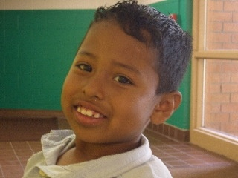
Hearing
Status
Communication
Approaches
Assistive
Technology
Options
Families
Communication Access
Additional
Needs
Deaf
Hard of Hearing
Cochlear Implant?
Hearing Aids?
Co-occurring Disabilities
English Language Learners
Listening-Speaking
English Sign
ASL
Interpreting
Type:
ASL
SEE
CASE
Oral
Cued Speech
Level:
Elementary
Secondary
Transcription
CART
Captioning
Auditory Communication Devices
Visual Communication Devices
Alerting Devices
Dreams
Knowledge
Acceptance
Need for resources & training
Notes:
Educating deaf children is complicated
Each one is unique

Slide 4
Today’s Topics
Importance of Access
Communication
Education
Technology
Development of Self, Self-Concept, Self-Determination, Self-Advocacy
Strategies Considerations & Discussion
Notes:
Our students enjoy the life experiences they value and realize personal responsibility for participation inthose experiences.

Slide 5
ACCESS
Communication
Technology
Education

Slide 6
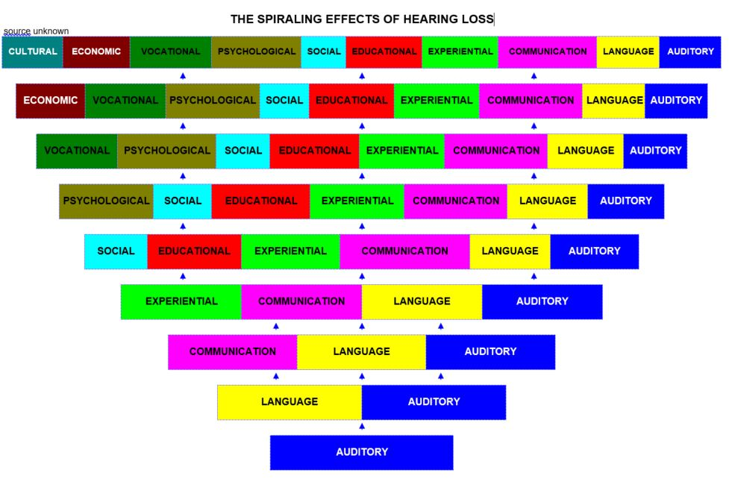
Author Unknown

Slide 7
Communication Access: What does it mean to you?
Communication
ACCESS

Slide 8
Cheryl’s definition: Accessible Education
Access to receive information
Language to identify what is received
Cognition to process and derive meaning
Environment that supports active participate in dialogue and application of knowledge
Communication access occurs when there is “shared meaning”.
Notes:
Adjsuted to language and knowledge of content
Dialogue
Communication ease

Slide 9
Communication Access Considerations
Language
Expressive
Classroom Communication Access
Attention/Fatigue
Speech Understanding
Pragmatic
Executive Function
Distance listening/listening in noise
Self-advocacy
Classroom acoustics
Classroom participation
Assistive technology (HAT, captioning, instructional technology, social media)
Receptive
Notes:
Language – student’s status
Classroom – considerations that complicate access

Slide 10
Communication Approaches vs Modes of Communication
Touch & other Sensory Inputs
Drawing/ Writing
Signing
Listening & Speaking
?
Speech Reading
Cueing
Fingerspelling

Slide 11
Communication Approaches vs Modes of Communication
Auditory
Auditory-Visual
Visual

Slide 12
Communication Mode Continuum: Receptive
A Av AV Va V
Auditory Only
Auditory w/visual support
Auditory/ Visual (Simultaneous Communication)
Visual w/ auditory support
Visual Only
1:1 communication, therapy
Small Group
Classroom – Lecture
Classroom - Discussion
Classroom - Cooperative Learning Groups
Home
Car
Theater

Slide 13
Communication Mode Continuum: Expressive
O Os OS So S
Fully Oral
Mostly Oral
Oral/Sign
(Simultaneous Communication)
Mostly Sign
Sign Only
Communication Partners
Communication Ease
Preferred Communication Mode

Slide 14
Communication Approaches
MODE | APPROACH
Primarily Auditory | Listening and Spoken Language (LSL)
Auditory with Visual Support | Auditory - Oral
Auditory – Visual | Cued Speech Bilingual-Bimodal
Visual with Auditory Support | Simultaneous Communication
Primarily Visual | Manually Coded English ASL Bilingualism

Slide 15
OCHL ACCESS: Summary of Evidence M.P. Moeller, Boys Town National Research Hospital
Audibility influences language growth rates
Carefully Fit Devices with low error
Consistently worn devices
Environments that are language-rich and responsive
Selected aspects of language at risk and need emphasis
Service provision guided by research and progress monitoring
A
C
C
E
S
S
Moeller & Tomblin (2015). Outcomes of Children with Hearing Loss, EAR & HEARING
Notes:
Outcomes of Children with Hearing Loss - add Ear & Hearing reference

Slide 16
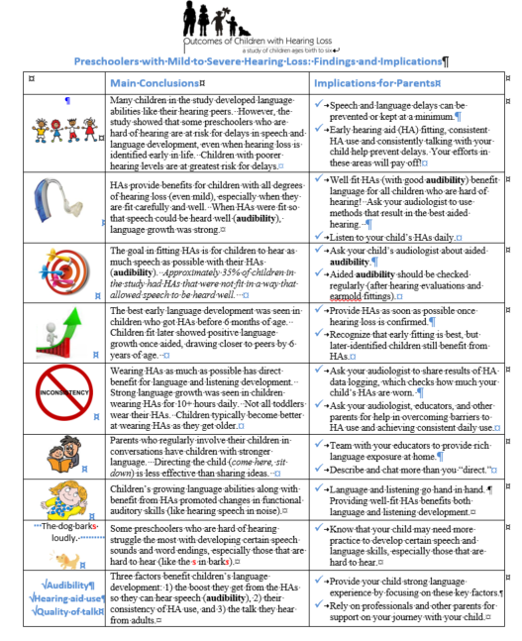
The Importance of Audibility
Outcomes of Children with Hearing Loss Study – OCHL
Parent Handout
http://ochlstudy.org/parent-handout.html

Slide 17
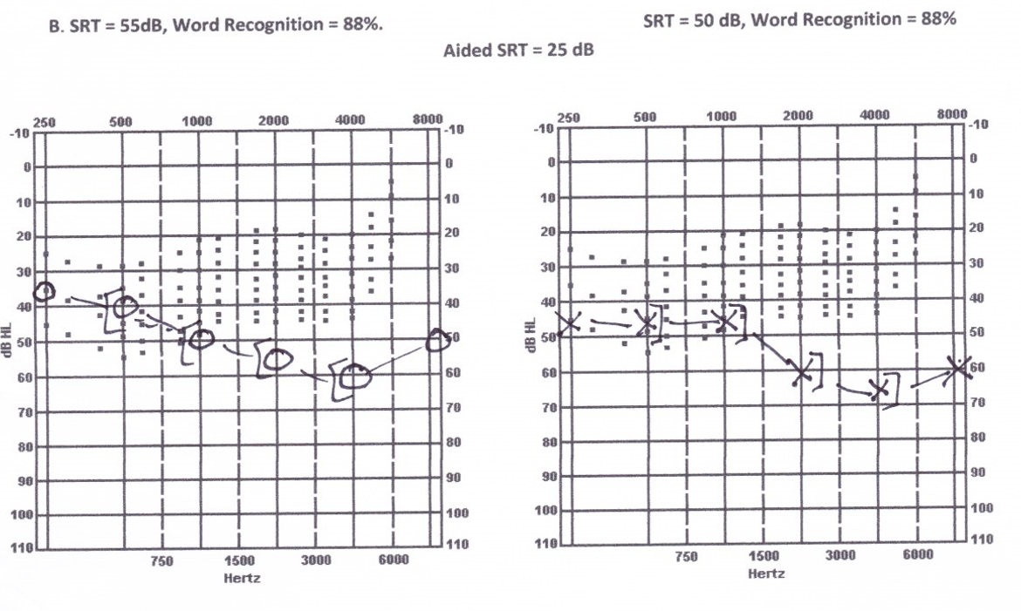
Count-the-Dot Audiogram
Notes:
RE: .13
LE: .11

Slide 18
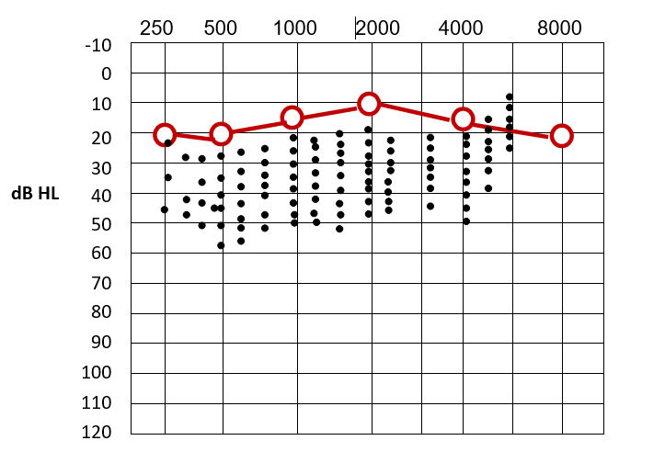
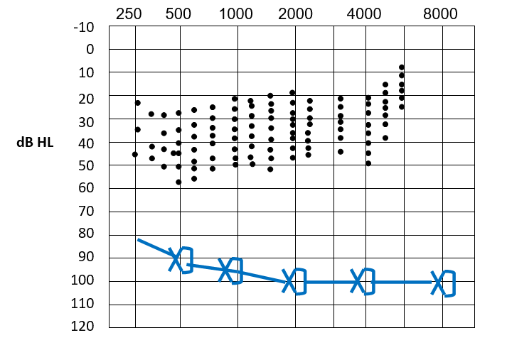
Audibility: Count-the-Dots
Notes:
What does it mean for Single-sided Deafness
RE:.95
LE: 0

Slide 19
Minimal, Mild, Unilateral, Single-sided Deafness (MMUSSD) Educational Audiology Association (2017); School-Based Audiology Advocacy Series www.edaud.org
Difficulties understanding speech both in ideal and in challenging listening environments such as the classroom setting (Crandell, 1993) and poorer performance on complex listening tasks (Lewis et al., 2014).
For those with UHL, difficulties locating the direction of sounds (Bess, 1986).
Increased risk of speech production errors, language delays and deficits especially in structural language (Tharpe, 2008; Walker et al., 2015; Winiger et al., 2016).
Phonological delays and difficulties with reading comprehension (Ross et al., 2008).

Slide 20
Minimal, Mild, Unilateral, Single-sided Deafness (MMUSSD) Educational Audiology Association (2017); School-Based Audiology Advocacy Series www.edaud.org
Low attention, lack of motivation, poor attention in class, and reduced class participation (Flexer, 1995; Porter et al., 2013)
Behavioral problems associated with high internal stress such as noncompliance, aggression, impulsivity, and inflexibility. (Winiger et al., 2016).
Strained communication with peers, difficulties making friends, and poorer peer relations (Tharpe, 2008; Winiger, et al., 2016).
Low self-esteem (Bess, Dodd-Murphy, & Parker, 1998; Winiger et al., 2016).
Higher fatigue, increased listening effort, and stress levels as compared to peers (Bess, Gustafson, & Hornsby 2014; Tharpe, 2008; Lieu et al., 2012).

Slide 21
ACCESS
Communication
Technology
Education

Slide 22
Education Access: What does it mean to you?
Education
ACCESS

Slide 23
Cheryl’s definition: Accessible Education
Instruction adjusted to student’s level
Active participation
Pre-teaching/ post-teaching
Instruction supports student’s abilities and knowledge
Learning occurs when there is knowledge of language and vocabulary, content is linked to experience or previous learning…
Notes:
Adjsuted to language and knowledge of content
Dialogue
Communication ease

Slide 24
Challenges of Inclusion in Early Childhood Inclusion in Early Childhood Education Programs U.S. Department of Health and Human Services & U.S. Department of Education (September 14, 2015). Policy Statement on Inclusion of Children with Disabilities in Early Childhood Programs
Full communication access to all activities (sign/visual/auditory)
Visually oriented environment
Interactions with adults/peers who are deaf and hard of hearing or deaf/blind
Language skills within 1-2 yrs of class
Progress: 1 years growth in 1 year
Least Restrictive Environment (LRE)
Separate is not equal (Brown vs Board of Education)
Can equal occur in general ed classroom?
Is Least Restrictive Environment a Language Rich Environment?

Slide 25
Rights: IDEA & 504
IDEA - provides educational rights and benefits for children with disabilities
Free Appropriate Public Education (FAPE)
Audiology services
Assistive technology and assistive technology services
Routine checking of hearing aids and external component of surgically implanted devices
IEPs & Consideration of special factors
504 – persons with qualified disabilities must be provided accommodations, does not require specially designed instruction, mitigating measure cannot exclude students

Slide 26
PART B DEVELOPMENT, REVIEW, AND REVISION OF IEP, Consideration of special factors 34CFR300.324(2)
The IEP Team must-
(iv) Consider the communication needs of the child, and in the case of a child who is deaf or hard of hearing,
consider the child’s language and communication needs,
opportunities for direct communications with peers and professional personnel in the child’s language and communication mode,
academic level,
and full range of needs, including opportunities for direct instruction in the child’s language and communication mode;
(v) Consider whether the child needs assistive technology devices and services.

Slide 27
IDEA – ADA (Title II) - 504
 | IDEA | ADA-Title II | 504
Communication Provisions | Schools must provide a FAPE designed to provide meaningful educational benefit through an IEP; special considerations [IDEA 300.324 (2) (iv-v)] | Schools must ensure that communication with students with disabilities is as effective as communication for students without disabilities…affording an equal opportunity to gain the same benefit, or to reach the same level of achievement as that provided to others and to participate and enjoy the benefits of the district’s services, programs, and activities.

Slide 28
Rights: ADA Effective Communication
Equal to nondisabled peers
Primary consideration given to requests of parents and students
Unless school can prove that a different aid or service is as effective to meet communication needs or
School can prove the aid or service would result in a fundamental alteration of undue administrative burden
Provided in a timely manner
Protect the privacy and independence of the individual
Continuously evaluate students to ensure they are receiving effective communication
Qualified interpreter is able to interpret as effectively, accurately and impartially, both receptively and expressively, using any necessary specialized vocabulary.

Slide 29
How are effective communication aids and services documented?
Present Levels of Functioning
Supports and Services
Modifications and Accommodations
Annual Goals
Measurement of Progress
504 Plan
IEP
Documentation of Disability
Accommodations, Auxiliary Aids & Services

Slide 30
IEP/504 Checklist

Slide 31
PARC: Placement And Readiness Checklists
The Student: Readiness Checklists
General Education Inclusion Readiness (adapted from Nevins & Chute, 1996)
Interpreted/Transliterated Education Readiness (adapted from Schick, 2004)
Captioning/Transcribing Readiness Checklist
Instructional Communication Access (adapted from Children’s Hospital of Boston, 2003)
The Environment: Placement Checklists
Preschool/Kindergarten
Elementary
Secondary
Notes:
Readiness Checklists – ratings on rubric continuum 1-5; for general classroom placement ratings of 4 & 5 are desired; ratings of 1-2 indicate student is not ready for placement

Slide 34
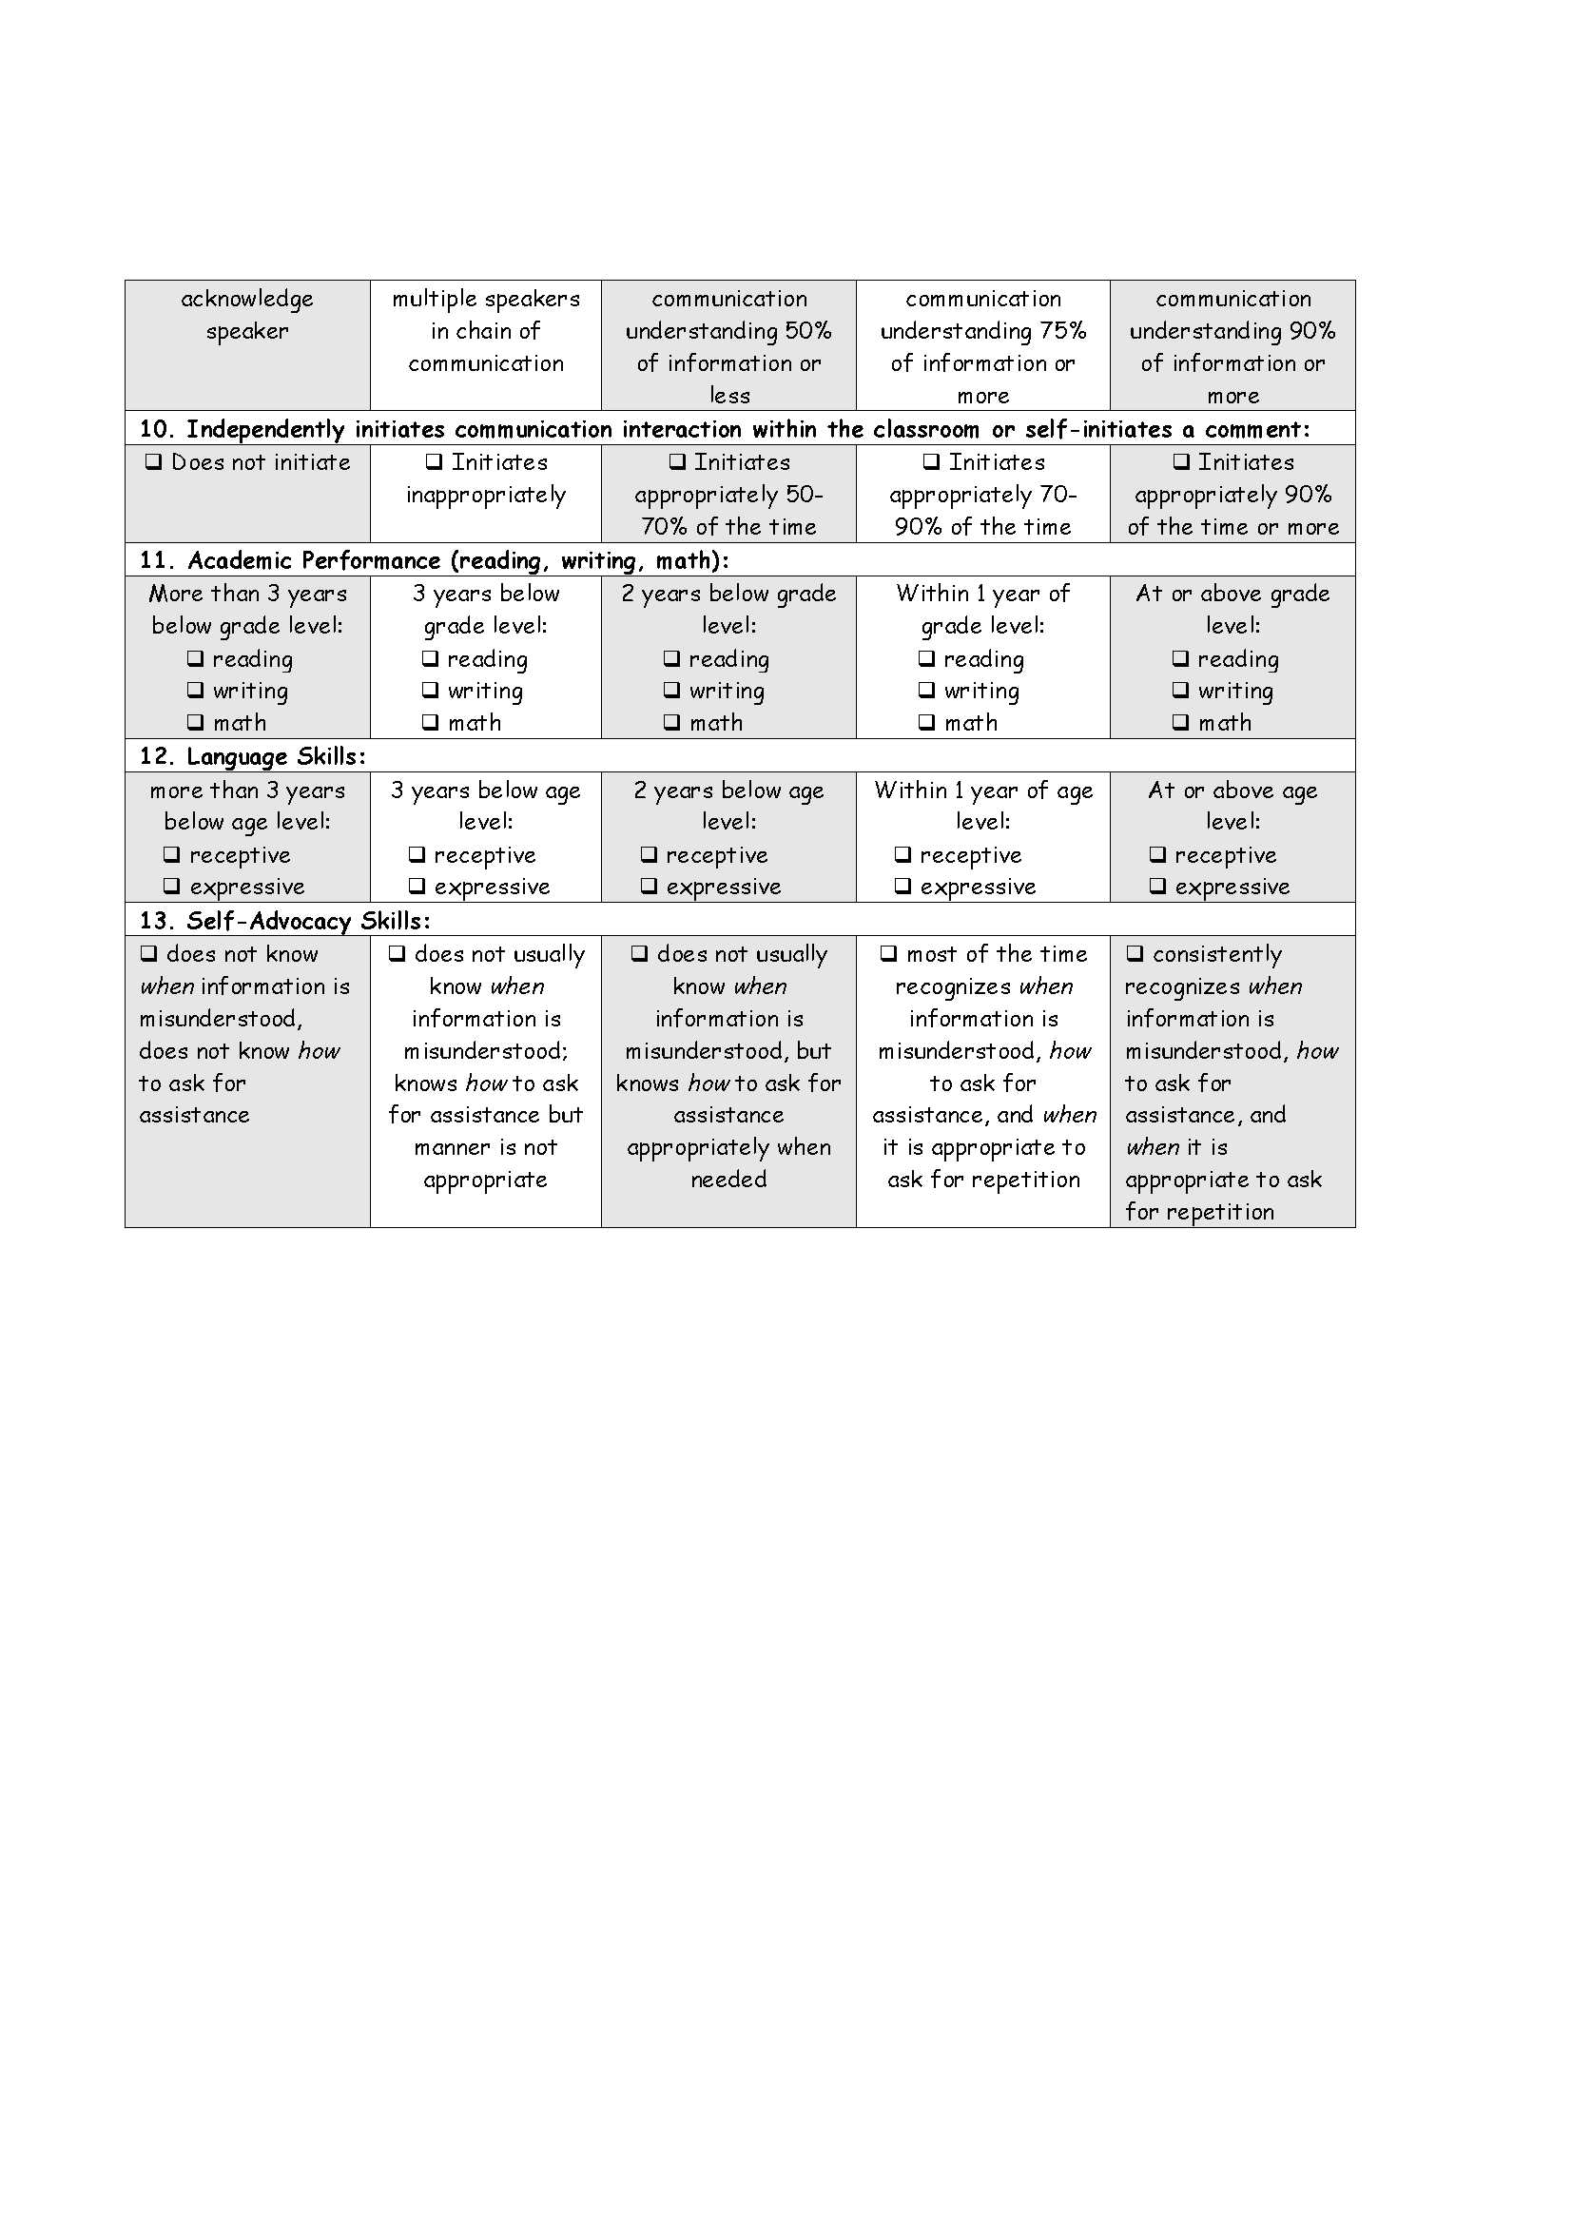

Slide 35
ACCESS
Communication
Technology
Education

Slide 36
Technology Access: What does it look like?
Technology
ACCESS

Slide 37
Cheryl’s definition: Technology to Access Education
Hearing Assistance Technology
Captioning
Connectivity to classroom/ instructional technology & social media
Technology must be planned in advance and should be part of Universal Deisgn for Learning (UDL)
Technology must be managed so that it is used appropriately and it is working consistently
Notes:
Adjsuted to language and knowledge of content
Dialogue
Communication ease

Slide 38
Beyond the Fitting Appointment: Patterns of Hearing Aid and FM System Use in the Classroom Davis, Gustafson, Hornsby, & Bess (AAA, 2015)
N=26, grades 1-7
22/26 were consistent hearing aid users (85%)
6/22 (36%) of these were never observed using FM
Personal & CADS
Notes:
Figure 4 - FM use in the Classroom. Percentages of observed use of an FM system in participants by category: “consistent user, “variable user”, or “non-user”. Note the total number of children in this figure is less than for previous figures, as only 26 children had parents who reported an FM system was available for use in their child’s classroom
FM and HA Use Group: • Of the 26 children with reportedly available FM, 22 were observed to be consistent HA users. • 8/22 (36%) of these consistent HA users were never observed using an FM system.
Variation in FM Technology: • Of the children with observed variable or consistent FM system use (n=15), 7 had sound-field systems, 6 had personal FM, and 2 had both sound-field and personal.
FM and Grade Level: • The majority of children (65%) with reportedly available FM systems were between 1-4th grade. • 50% of children between 5-7th grades did not have an FM system or their parents didn’t know if they had one.
FM Use and Degree of Hearing Loss: • Better-ear 4-PTA was not significantly related to FM system use/non-use (p=.222
Although it is well documented that children require more favorable signal-to-noise ratios than adults for optimal listening and learning3, classroom noise levels continue to exceed recommended minimum standards5,6. Children with hearing loss, even those who wear hearing aids (HAs), generally encounter difficulty learning and understanding speech in the noisy classroom.1,4 These difficulties often lead to the recommendation of a frequency-modulated (FM) system to improve the signal-to-noise ratio of the teacher’s voice. Device use at school is of particular interest for audiologists, as school age children spend a majority of their time (7-8 hours a day, 5 days a week) in this setting. Unfortunately, if the children are not consistently wearing their HAs and/or using the FM system, they are unable to take advantage of increased audibility for learning in the classroom environment. Furthermore, the shortage of educational audiologists across the US has resulted in teachers and students bearing the responsibility of monitoring hearing aid and FM system use in the classroom so as to ensure that children with hearing loss have adequate access to the auditory signal (e.g. classroom instruction). Clinical audiologists typically rely on parental report of device use/non-use in the classroom which have the potential to drive technology recommendations and fittings. However, recent reports indicate that parents typically over-estimate device use, leaving the clinical audiologist without an accurate portrayal of the child’s hearing assistive technology use at school.
Purpose: 1) Document parent-reported and researcher-observed patterns of hearing aid(s) and/or FM system(s) use by students in the classroom. 2) Identify potential characteristics that may influence device use or non-use to improve fitting and counseling for these specific groups.
Methods: Data were obtained as part of a larger ongoing study examining listening effort and fatigue in school-age children (6 to 12 years old) with hearing loss. All participants had bilateral mild-tomoderate hearing loss (MMHL) and were monolingual speakers of English. Children spent at least two hours per school day in a general education classroom. Those with parent-reported diagnoses of cognitive impairment, autism spectrum disorder, and other development disorders were excluded.
HA and FM system use was documented in two ways for each participant:
1. Parents reported an estimate of their child’s average HA use time during typical school days and indicated whether the child had an FM system available for use in the classroom.
2. Participants’ classrooms were visited by a research assistant on two typical school days at 10:00 am and 2:00 pm, for a total of four observations, to document if the child was wearing his/her HAs and/or if an FM system was in use. The following classifications were assigned to each child: • Nonuser – never observed using the device(s) • Variable user – observed 1-3 times using the device(s) • Consistent user – observed all 4 times using the device(s)
Variable Value Number of participants with hearing aids 38
Number of participants with FM system 26
Number of males 18, females 8
Participants with mothers who attend at least some college 32
Participants who failed at least one grade 6
Average noise level of occupied classroom 63.28 dBA

Slide 39
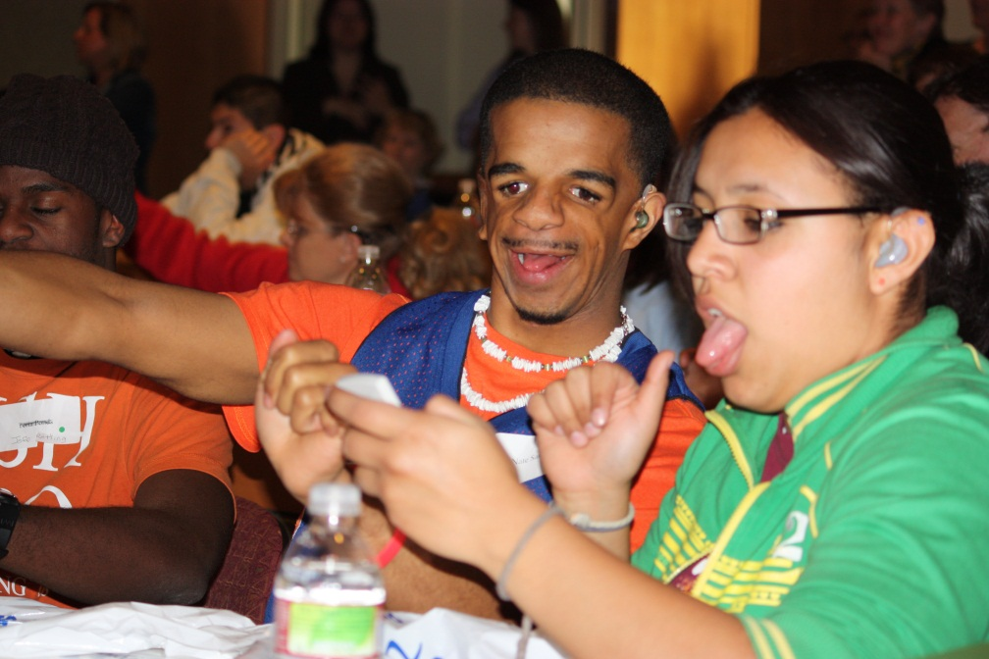
What is the Problem?
Student?
School/Teacher/Staff?
Technology?
Support?
Knowledge?
Orientation and Training?
Notes:
Student – self-esteem, acceptance of HL, doesn’t want to be different, does it make a difference
School/Teacher/Staff – don’t need it – my voice is loud enough, no time to implement
Technology – is it working well consistently
Support – was their training for its use, who does troubleshooting and how quickly is it available, do parents support it
Knowledge – what is the purpose, how does it work, why is it necessary, how does it improve access, laws and my rights
Orientation and Training – was it provided, sufficient in scope, on-going support

Slide 40
Why Do Students with Hearing Impairments Resist Wearing FM Amplification?
Jennifer Franks
Eastern Michigan University
MA Thesis, 2008
Participants: 68 (45.3% return rate)
9 students, ages 8-18
5 parents
15 special educators
11 general educators
7 teachers of speech and language
8 audiologists
12 other personnel working with DHH students
Notes:
All participants attended or worked in schools in a single MI county
All students on IEPs for hearing impairment
All students had access to FM
45.3% (N=68) of those invited participated
9 students, ages 8-18
5 parents
15 special educators
11 general educators
7 teachers of speech and language
8 audiologists
12 other personnel working with DHH students
Survey – 15 questions + 2 open ended

Slide 41
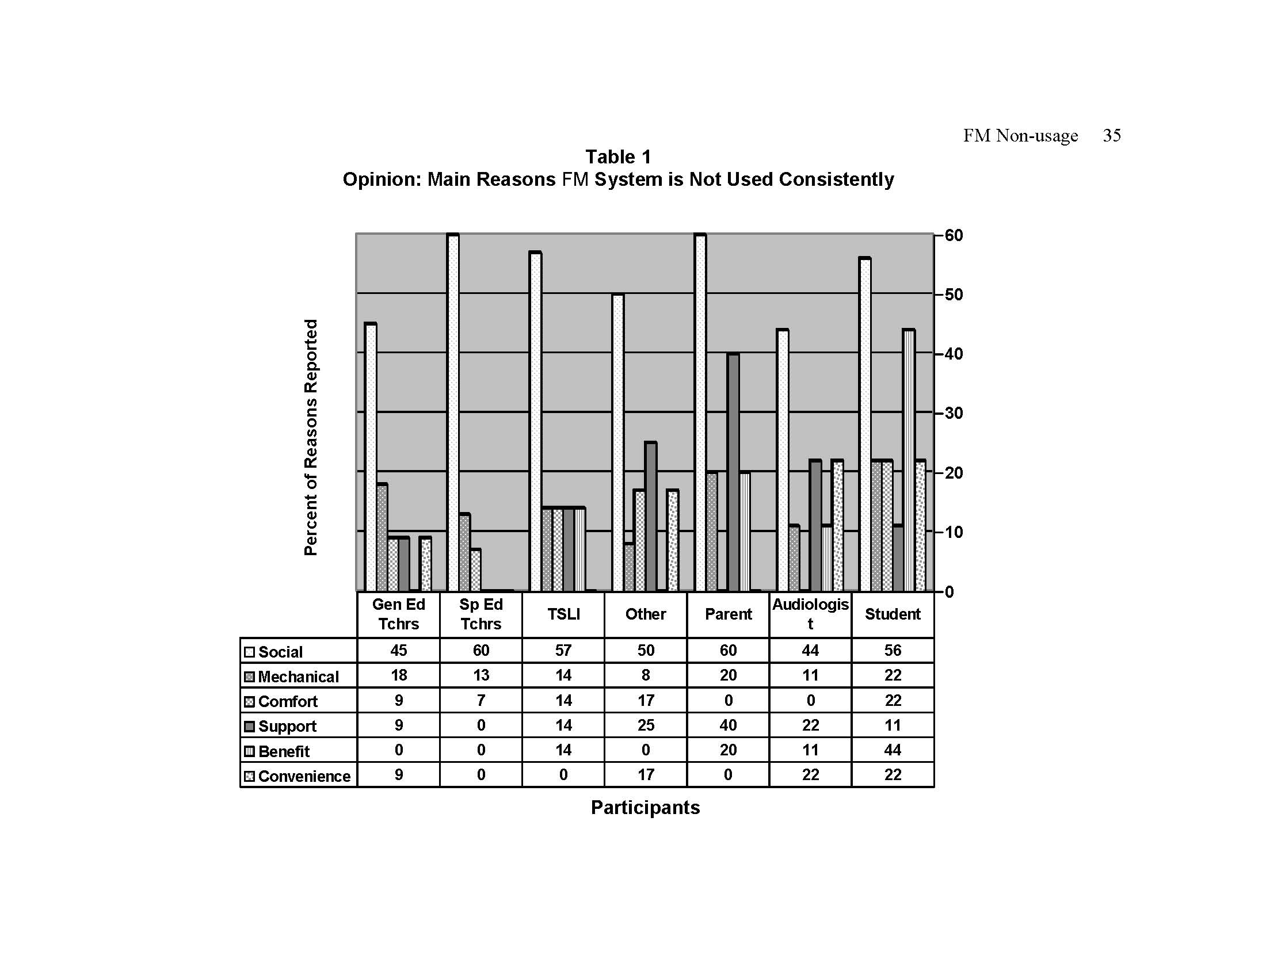

Slide 42
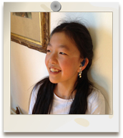
Development of Self, Self-Concept, Self-Determination, Self-Advocacy

Slide 43
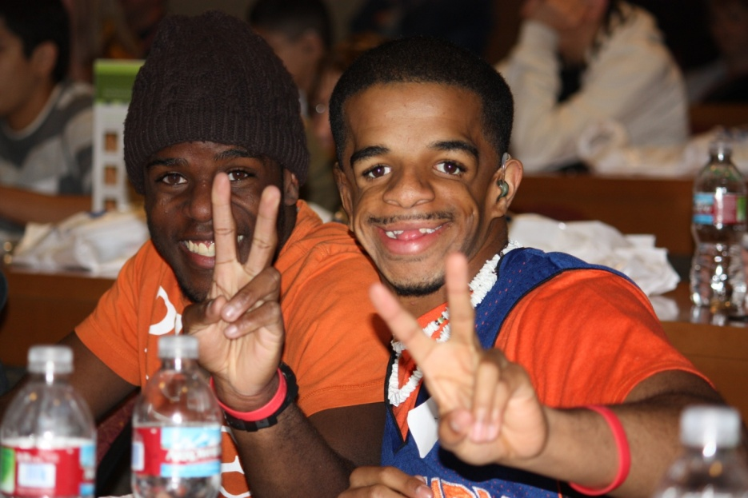
Development of Self: Who am I?
Self-Identity: who I am as a person
Deaf Identity: how does my hearing status affect me
Learning and accepting who I am
Not ears
Not an audiogram
Not a “freak”
Not “retarded”
Just a person like everyone else!

Slide 44
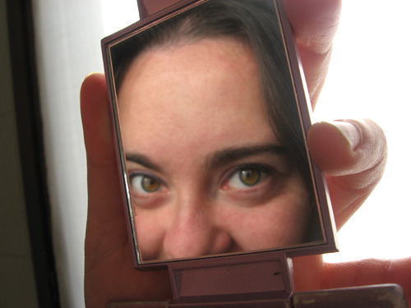
Development of Self
What are my strengths? What are my challenges? What are my barriers? Who will aid me in overcoming my barriers?
How do I interact with others?

Slide 45
Social-Emotional Learning (SEL) Competency Clusters*
Relationship
Skills
Self-
awareness
Social-Emotional
Learning
Social
Awareness
Self-
management
*Collaborative for Academic, Social, and Emotional Learning (CASEL) www.casel.org
Responsible Decision Making

Slide 46
Relationship Skills
Perceiving & interpreting situations
Determining what to say
Executive Function
Appropriate social conversation rules
Social Relationships & Friendships
Social Communication Skills
Social Cognitive Skills
Notes:
Pragmatic Language
Social Communication Skills
Appropriate social rules for greetings, exiting conversations, thank you, getting attention
Social Cognitive Skills
Perceiving and interpreting situations
Determining what to say (initiate and response)
Executive Function
Social Relationships impacted by awkward
Friendships

Slide 47
Theory of Self-Determination
Relatedness
Competency
Autonomy
Notes:
The Theory of self-Determination
Underlying principle: children have the natural propensity to take in behaviours and make them their own
3 Central Constructs:
Relatedness – the starting point of self-determintation
children have the desire or need for positive, understanding relationships that facilitate motivation and growth
2. Competency:
desire to succeed in achievement type tasks
by doing so we perceive our own success
we learn this through the process of active engagement
active engagement allows us to learn about yourself and the environment
and therefore to feel in control and feel more successful
3. Autonomy
this relates to feeling independent and able to have a choice to make
choicefulness is essential for self-determination
supported by a non-coersive family and social environment
Autonomy and the possibility to make ones own choices is essential for self-determination
Choicefulness is correlated with:
Improved sense of well being
Improved academic functioning and adherence to care
Without it: there is decreased social development and identity construction

Slide 48
Development of Self-Determination: The right to direct one’s own life
Students with SD skills have a stronger chance of being successful in making the transition to adulthood, including employment and independence (Wehmeyer & Schwartz, 1997)
Study: One year post-graduation, students with higher levels of self-determination in high school were more likely to be living outside the home, employed for pay and earning more per hour than those with lower levels of self-determination.
Components of Self-Determination (University of IL at Chicago National Research & Training Center, 2002)
Free will Civil and human rights Freedom of choice Independence | Personal agency Self-direction Individual responsibility

Slide 49
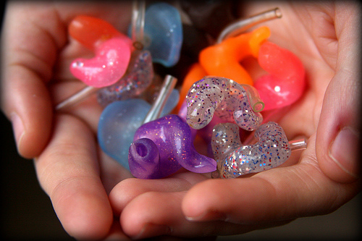
A more pragmatic definition: (Martin & Marshall, 1996)
A self-determined person:
Sets goals
Makes decisions
Sees options
Solves problems
Speaks for oneself
Understands what supports are needed for success
Knows how to evaluate outcomes

Slide 50
How do we facilitate Self-Determination?
Encourage problem solving
Support exploration of possibilities
Promote the development of self-esteem
Develop and understand the process of goal setting and planning
Promote reasonable risk taking
Help children understand their hearing loss
Promote choice making
Evaluating outcomes of choices and problem solving solutions
Promote self- advocacy
Slide 50
19.9.2017
Notes:
Who should do this: parents, teachers, puils, HCP’s all have a role
Why should we do this: SD skills enable children to actively and competently manage transitions at home and at school
In particular for children with hearing loss:
Help to understand their hearing loss
Strategies to cope with hearing loss
Work to internalise these skills

Slide 51
Roadblocks to Self-Determination
Roadblocks to Self-Determination
Difficulty acknowledging and/or accepting a difference
Unprepared to disclose their disability
Choose not to disclose
Wait to disclose AFTER they have significant problems
Anxious about a "new beginning" and do not want to be labeled
Examples of Failure - Audiology
Students who are not supported to use the technology
Self-advocacy attempts that are thwarted by the teacher
Parents who deny the need for, or do not support, hearing instrument technology
School cultures that are not flexible to meet individual needs of students
Technology that does not work

Slide 52
Mason’s IEP Report Video https://www.youtube.com/v/i9HNZQG-bIw
Notes:
Janel Frost’s son

Slide 53
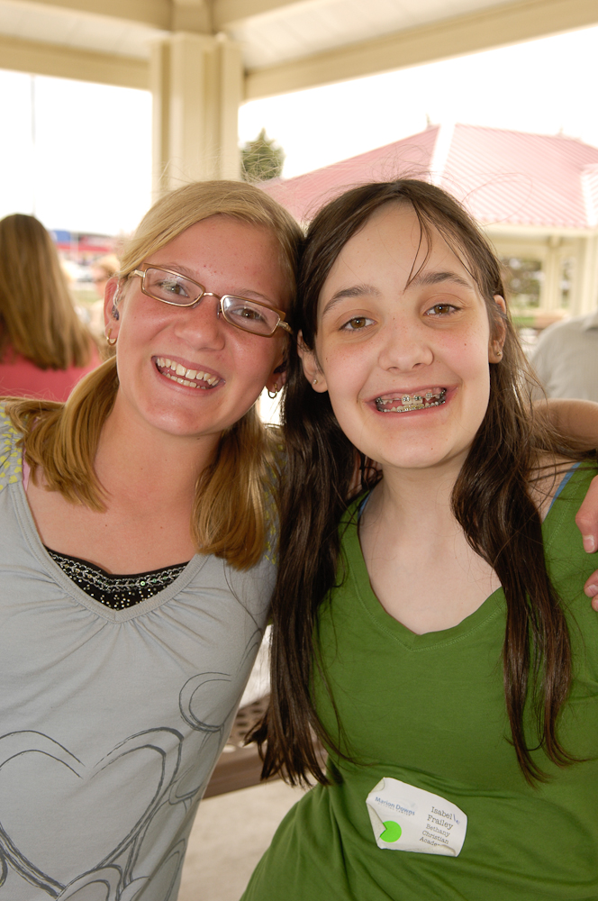
Strategies and Solutions

Slide 54
Tips for Promoting Self-Determination National Center on Secondary Education & Transition www.ncset.org
Promote choice making
Encourage exploration of possibilities
Promote reasonable risk taking
Encourage problem solving
Promote self-advocacy
Facilitate development of self-esteem
Develop goal setting and planning
Help youth understand their disabilities

Slide 55
Parent to Parent Tips to Develop Self-Determination Skills
Discuss strengths and weaknesses with your child
Help them develop strategies to overcome barriers
Set expectations for self-advocacy early and continue to expand as child gets older
Share with the IEP team how your child functions at home and in the community
Include self-detrmination and self-advocacy goals in the IEP
Always include the child’s input at IEP meetings; their involvement should increase each year so that the child’s eventually represents his/her self to devlop goals, needs, and services
Know your rights and teach them to your child
What does IDEA mean?
What does ADA mean and how is it different from IDEA?
Notes:
Pepnet.org has ADA video
Be sure child knows how to access/cite their rights through the Americans with Disabilities Act (ADA), Section II discusses communication access. Many entities are unaware of their responsibility of providing equal communication access, therefore, the individual with hearing loss often needs to educate employers, doctors offices, community events, etc. of their right to access spoken language and advocate for their needs. Citing the law is a powerful resource. This doesn’t mean that the individual can dictate who their interpreter is, but rather ensures that there is equal access.

Slide 56
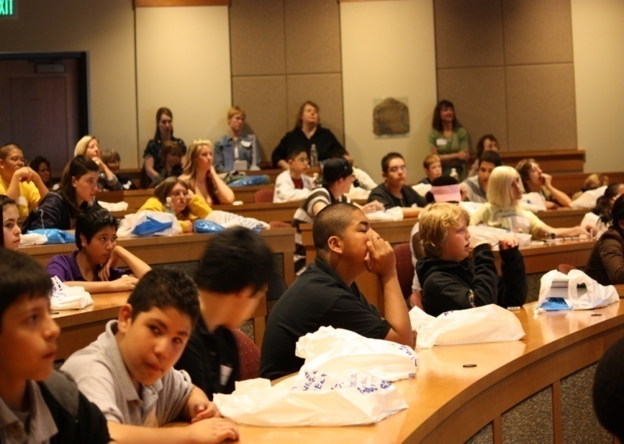
2. Judicious use of Amplification

Slide 57
Step 1. Potential Candidacy for HAT
Hearing Loss | Auditory Processing Deficit | Learning Disability
Auditory Neuropathy/Dys-synchrony
Language Deficit | Attention Deficit | English Language Learner
AAA Remote Microphone HAT for Children and Youth from Birth-21
Documented evidence
of listening or
learning problems?
No
Yes
Reconsider
Step 2. Considerations
[in and out of school]
Acoustic environment
Social/emotional
Functional
Support
Counsel
Monitor
Review
Contra-
Indications?
Yes
No
Step 3. Device Selection
Step 4. Fitting and Verification
Step 5. Implementation and Validation
Notes:
Source: AAA Clinical Practice Guidelines Remote Microphone Hearing Assistance Technologies for Children and Youth from Birth – 21 Years: Core Statement

Slide 58
Step 2. Considerations
[in and out of school]
Acoustic environment
Social/emotional
Functional
Support
Reconsider
Counsel
Monitor
Review
Contra-
Indications?
Yes
Motivation: Student & Teachers Self-Advocacy
Child & Family Social Acceptance
Attention & Fatigue Classroom Culture
Self-image Family Support
Notes:
Questionnaires: CPQ, SAC-A, SOAC-A
Contraindications: counseling and reconsideration
Other options: CADS

Slide 59
Considerations before fitting HAT: Classroom Listening Assessment
Classroom Observation
Acoustic Measurements
Noise, RT, Critical Distance
Questionnaires:
Teacher: (CHAPS, L.I.F.E.)
Student: (Classroom Participation Questionnaire, L.I.F.E., Self-Assessment of Communication-A, Significant Other Assessment of Communication-A)
Functional Assessment:
Functional Listening Evaluation (FLE)
Notes:
Questionnaires: CPQ, SAC-A, SOAC-A
Contraindications: counseling and reconsideration
Other options: CADS

Slide 60
Testimonials
Ethan: https://www.youtube.com/watch?v=TMv5UuSAsDs
Nicole (17): https://www.youtube.com/watch?v=mjTSp4fC-ws
Audrey (15): https://www.youtube.com/watch?v=tqwKzvTOUms
Audrey (18): https://drive.google.com/file/d/0B2y6mNHf9IWrR25jUnJ3Z0hvTlk/view
Teen Stories using Roger https://www.phonak.com/us/en/hearing-loss/being-a-teenager-with-hearing-loss.html

Slide 61
Ethan: https://www.youtube.com/watch?v=TMv5UuSAsDs

Slide 62
Transitioning out of School
3. Peer Group Opportunities
Notes:
Preparing for life after high school

Slide 64
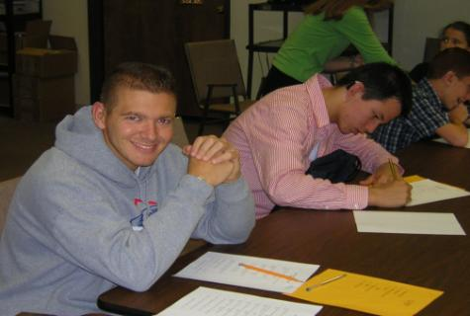
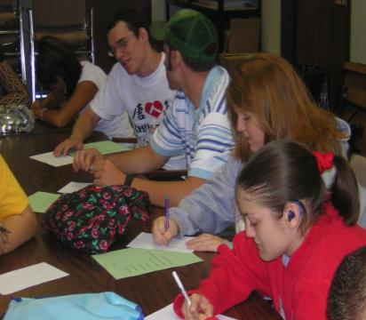
Hit It! Meeting Transition needs
Hearing Impaired Teens Interacting Together!
Meets quarterly
Grades 6–12
Multiple schools in different areas
Focus on self-advocacy
Focus on Transition Activities for IEP or Transition Plan
Carrie Spangler, Ohio
CarrieS@cybersummit.org
Notes:
Carrie

Slide 65
Notes:
Mindmapping

Slide 66
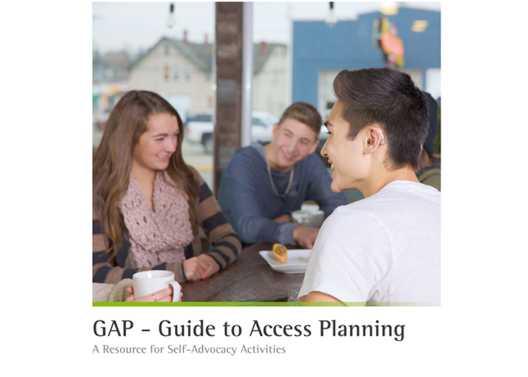
Professionals: https://www.phonakpro.com/us/en/resources/counseling-tools/pediatric/guide-to-access-planning/guide-to-access-planning.html
4. Resources
Consumers: https://www.phonak.com/us/en/support/children-and-parents/planning-guide-for-teens.html

Slide 67
GAP is…
A Learning Guide:
Self-Assessment Rights
Self-Advocacy Hearing Access Technology
Activities
Resources
Teens & Young Adults
FOR:
Teachers & Professionals
Parents
Notes:
PURPOSE
To promote self-advocacy skills and personal responsibility in teens and young adults
To provide a curriculum for teens and young adults who are deaf and hard of hearing, their parents, and professionals who serve them. The curriculum includes materials to promote knowledge about hearing loss, use of hearing assistance technology and self-advocacy skills beyond high school.
To compliment high school post-secondary transition activities with meaningful materials and activities.

Slide 68
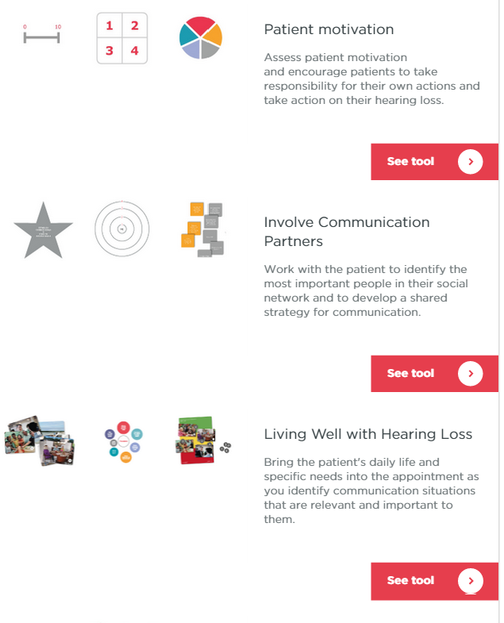
Ida Institute, Denmark http://idainstitute.com/toolbox/

Slide 69
http://idainstitute.com/toolbox/transitions_management/
IDA Institute
Transitions Management

Slide 70
http://www.pepnet.org/map-it

Slide 71
H & V On-Line Module for Parents of Transition Age Students
http://handsandvoices.org/hvcourses/
Topics included in this module:
Laws and Key Information Parents Need to Know about the Transition Process
From Parent Advocacy to Student Advocacy
Technology Transitions
The Parenting Aspects of Transition
Strategies to Assist the Process of Transition
Each topic in the module includes:
Learning Objectives
Activities
Topical Readings
Additional Resources
Evaluation
This Hands & Voices training module was made possible through a project of the Rehabilitation Engineering Research Center on Technology for Individuals who are Deaf or Hard of Hearing, funded by the National Institute on Disability, Independent Living, and Rehabilitation Research.

Slide 72
Tools for Practice
Assessment:
Questionnaires/Self-Assessments
Classroom Listening Assessment
Self-Advocacy Assessment
Guidelines:
AAA HAT Guidelines (www.audiology.org)
Resources:
www.successforkidswithhearingloss.com
Guide to Access Planning (GAP)
https://www.phonakpro.com/us/en/resources/counseling-tools/pediatric/guide-to-access-planning/guide-to-access-planning.html
Ida Institute Tool Box
My World
Living Well
Transitions Management
H&V Transition for Parents
http://handsandvoices.org/hvcourses/
.
Self-Advocacy Curricula
C.O.A.C.H. Self-Advocacy & Transition Skills for Secondary Students who are Deaf or Hard of Hearing, Lynn Price
Wehmeyer, M. et al (2000). Promoting Causal Agency: The Self-Determined Learning Model of Instruction. Exceptional Children 66(4), 439-453.
Knowledge is Power, Mississippi Bend Area Education Agency, EAA
Self-Advocacy for Students who are Deaf or Hard of Hearing, K. English, GAP CD
Notes:
K. English text – 4 units, 14 lessons, ProEd, 1997 (out of print)

Slide 73
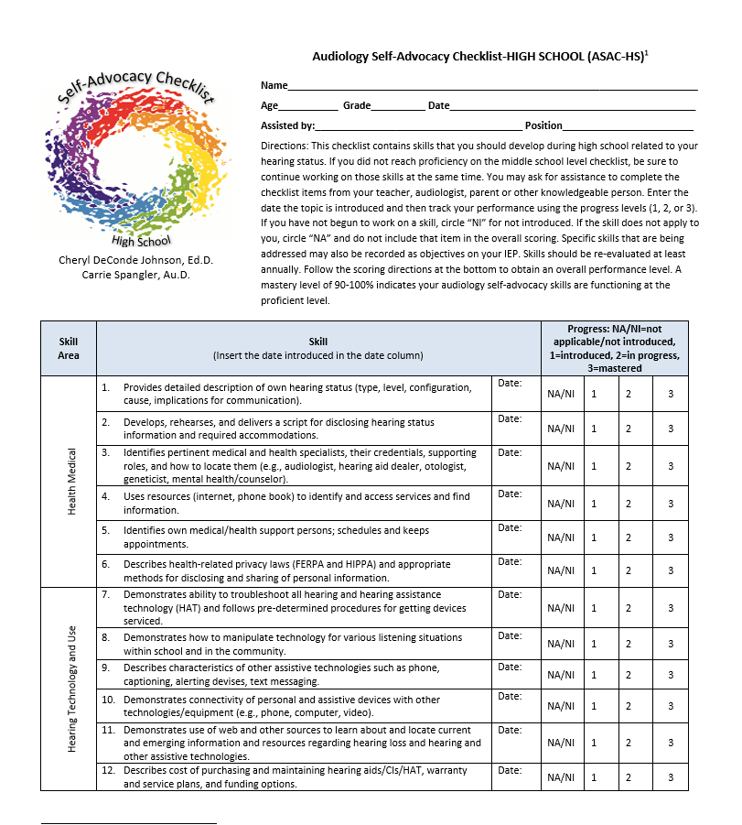
Audiology Self-Advocacy Checklists (Johnson & Spangler, 2013)
Teacher Forms
Elementary
Middle School
High School (Student)
Available in Guide to Access Planning or www.adevantage.com

Slide 74
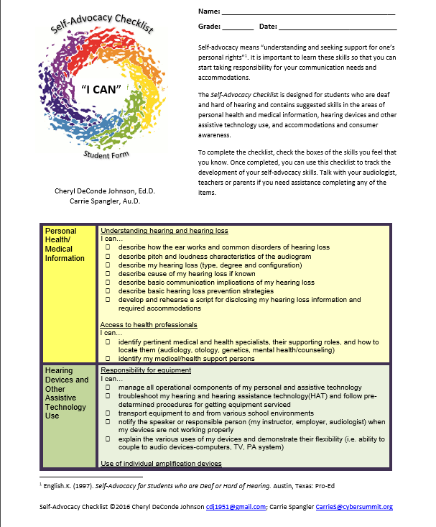
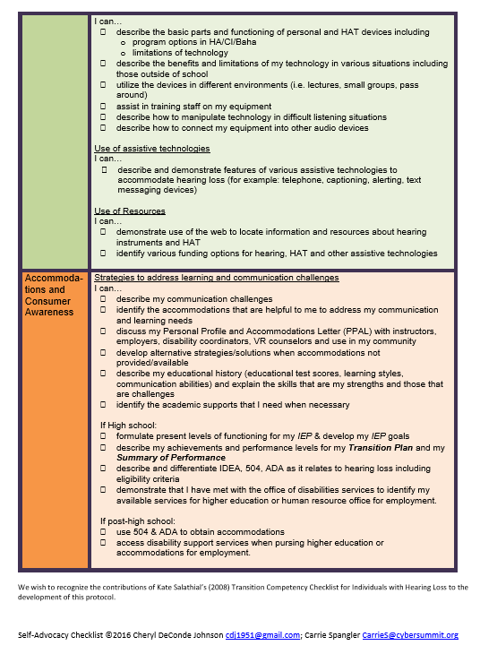

Slide 75
EAA: Input Requested https://www.surveymmonkey.com/r/WLSYC7K www.edaud.org
Supporting Student who are Deaf and Hard of Hearing: Shared and Suggested Roles of Educational Audiologists, Teachers of the Deaf and Hard of Hearing, and Speech-Language Pathologists
A checklist to discuss and distribute roles/responsibilities.

Slide 76
Learning Outcomes
Differentiate between self-determination and self-advocacy.
Describe a strategy for supporting families and their children as they move from preschool to adulthood.
Discuss strategies for implementing self-determination and self-advocacy goals into the IEP.

