Slide 1
Supporting Children and Teens As They Navigate Their Access
Cheryl DeConde Johnson
The ADEvantage: Audiology-Deaf Education vantage consulting

Slide 2
Resiliency/social support
Parent-to-Parent Support for Parents with Children who are Deaf or Hard of Hearing: A Conceptual Framework (Henderson, Johnson, & Moodie (2014)
Conceptual framework of parent-to-parent support based upon extensive literature review. Components include:
well-being: parent, family and child;
knowledge: advocacy, system navigation & education;
empowerment: confidence and competence. Learning Parents (child recently diagnosed) and Supporting Parents (lived experience) are described related to mutuality and connectedness.
The article discusses key predictors of well-being for parents and families and for DHH children.

Slide 3
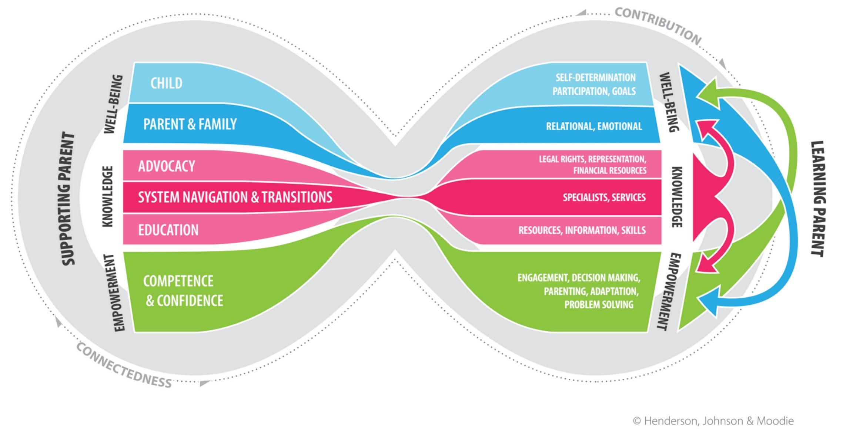

Slide 4
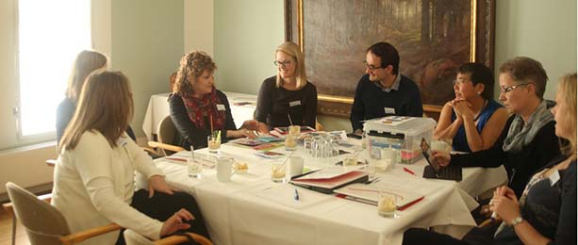
Ida Institute: Person-Centered Care
Established in 2007
Funded by the Oticon Foundation
Non-profit organization
Mission
To develop and integrate person-centered care in hearing rehabilitation

Slide 5
Outline for Today
Case Study Introduction
Rationale for Supporting Student Transitions
Transitions Management Development Process
Self-Determination Theory
Orientation to Transitions Management Tool
Discussion

Slide 6
Kathleen’s Story
Reflect on video:
What struck you as you watched…
from Kathleen’s perspective
From Kathleen’s parent’s perspective
What role would an audiologist play?
Notes:
10 Min clip to set stage for presentation/discussion

Slide 7
Kathleen’s Story Video Reflection
In Pairs
What struck you as you watched…
from Kathleen’s perspective
From Kathleen’s parent’s perspective
What role would an audiologist play?
Large Group Sharing
Notes:
10 Min clip to set stage for presentation/discussion

Slide 8
Rites of Passage
Ancient ceremonies to recognize the changes that are inherent in our movement through life.
Symbolize a life journey from dependence to autonomy, the development of new life skills, and the movement from focus on self to relationship with others.
In the educational framework, we too have rites of passage which support those changes in families and children.
Those rites of passage we have defined for this project as transitions.

Slide 9
Rationale for Supporting Student Transitions
Transitions are not done alone; they are done in contact with others through dialogue and exploration.
Different skills, attitudes, exploration and reflection are needed at each educational transition for parents and children.
Preparation for each transition will ready the families for the changes ahead.
Parents’ and children’s abilities to negotiate those transitions is key to their movement through the educational system.

Slide 10
How to Support Transitions
Identify key transitions in educational settings
Name those transitions for parents and children
Determine what will be needed for upcoming transition
Dialogue with parents and children about upcoming transition
Create opportunities for reflection, exploration and experience
Recognize the parents’ and children’s growth

Slide 11
Social-Emotional Learning (SEL) Competency Clusters*
Self-
awareness
Relationship
Skills
Social-Emotional
Learning
Social
Awareness
Self-
management
Responsible Decision Making
*Collaborative for Academic, Social, and Emotional Learning (CASEL)

Slide 12
Relationship Skills
Perceiving & interpreting situations
Determining what to say
Executive Function
Appropriate social conversation rules
Social Communication Skills
Social Cognitive Skills
Social Relationships & Friendships
Notes:
Pragmatic Language
Social Communication Skills
Appropriate social rules for greetings, exiting conversations, thank you, getting attention
Social Cognitive Skills
Perceiving and interpreting situations
Determining what to say (initiate and response)
Executive Function
Social Relationships impacted by awkward
Friendships

Slide 13
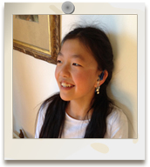
Theory of Self-Determination
Relatedness
Competency
Autonomy
Notes:
The Theory of self-Determination
Underlying principle: children have the natural propensity to take in behaviours and make them their own
3 Central Constructs:
Relatedness – the starting point of self-determintation
children have the desire or need for positive, understanding relationships that facilitate motivation and growth
2. Competency:
desire to succeed in achievement type tasks
by doing so we perceive our own success
we learn this through the process of active engagement
active engagement allows us to learn about yourself and the environment
and therefore to feel in control and feel more successful
3. Autonomy
this relates to feeling independent and able to have a choice to make
choicefulness is essential for self-determination
supported by a non-coersive family and social environment
Autonomy and the possibility to make ones own choices is essential for self-determination
Choicefulness is correlated with:
Improved sense of well being
Improved academic functioning and adherence to care
Without it: there is decreased social development and identity construction

Slide 14
How do we facilitate Self-Determination?
Encourage problem solving
Support exploration of possibilities
Promote the development of self-esteem
Develop and understand the process of goal setting and planning
Promote reasonable risk taking
Help children understand their hearing loss
Promote choice making
Evaluating outcomes of choices and problem solving solutions
Promote self- advocacy
Slide 14
19.9.2017
Notes:
Who should do this: parents, teachers, puils, HCP’s all have a role
Why should we do this: SD skills enable children to actively and competently manage transitions at home and at school
In particular for children with hearing loss:
Help to understand their hearing loss
Strategies to cope with hearing loss
Work to internalise these skills

Slide 15
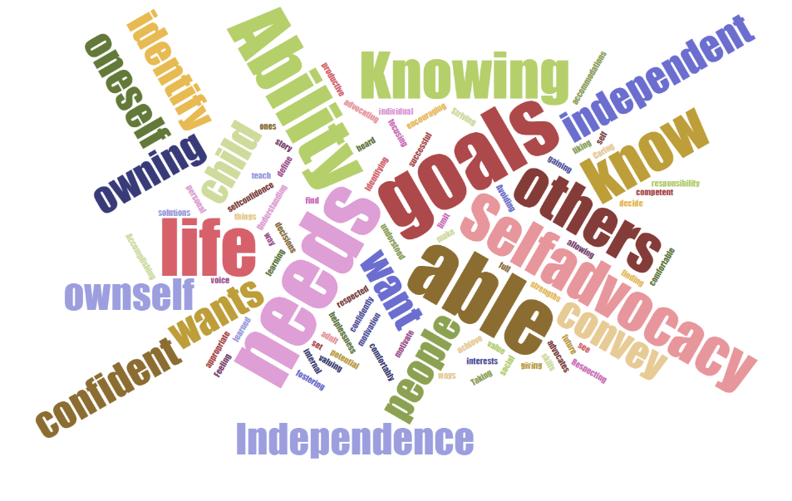
Parents Thoughts on Self-Determination: What does SD Mean for you and your child?
Notes:
Identify needs they have
Know solutions
Have appropriate people & social skills
be able to know oneself
know yourself and be able to voice it
find a way to achieve
Understanding ownself to be able to convey these to others
owning his needs; gaining confidence to convey these needs
teach him his needs for all learning accommodations
Ability to make decisions about her own life and future
Being able to decide your life
Be heard, understood and respected
able to set goals & see them through self-advocacy
Not allowing others to define or limit you
internal motivation and goals, independent of what people want for him
my child advocates for himself
Ability to be successful in life and knowing what you want from life
Identifying own needs wants, goals, and advocating for those
Knowing and owning your story
Ability to motivate ownself by focusing your personal strengths
Ability to identify yourself comfortably and confidently
Avoiding learned helplessness
Does what he wants to
Being confident, liking who you are
Knowing your value
Striving for your full potential while encouraging others to do the same
Caring for self
Being a competent, productive adult
Feeling confident and having goals
Self-advocate
Respecting my child as an individual, valuing her interests and fostering them,
Self-advocacy, confidence
Independence, being comfortable with who they are
Taking responsibility for oneself
Accomplishing ones goals
Not giving up, finding other ways to do things
Independence, self-confidence
Being independent

Slide 16
Orientation to the Transitions Management Tool

Slide 17
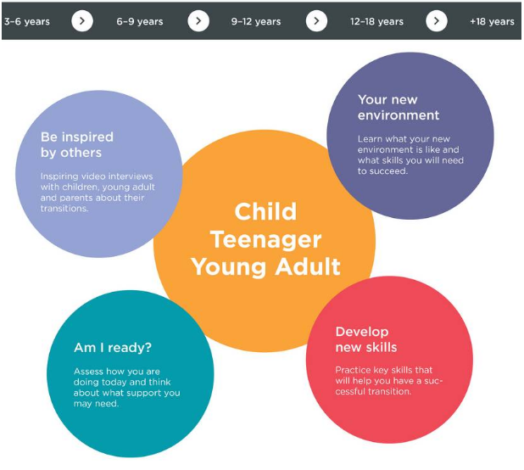
http://idainstitute.com/toolbox/transitions_management/

Slide 18
Happy and Healthy Lives
Consider how you make choices
and decision about different aspects of your lives.

Slide 19
Emotional Wellness
Emotional wellness is based on how you feel. It is important to our overall health that we keep a healthy emotional life. For younger children, this may mean spending time with adults or other children with hearing loss. This helps them learn to understand themselves and cope with the challenges life can bring. It also involves the ability to understand and share feelings such as anger, fear, sadness, hope, love, and happiness. For teens and young adults, it can mean being able to manage stress levels in school or college and having a positive acceptance of their hearing loss. It can also mean getting enough sleep and knowing when and how to ask for help.

Slide 20
Getting Started
First Step: Reflect on how you are doing now; what is important to you, what is working well, and areas where you need help:
Describe how your family communicates, and how you ensure each family member clearly understands what is being said.
Describe how you and your family make important decisions.
Describe how you and your family handle challenging or difficult situations.
What are your current goals for managing your hearing loss or (if parent) your child’s hearing loss?
What are your hopes and dreams (for yourself, or if parent, for your child)?

Slide 21
FRAMEWORK
Develop New Skills- practical suggestions on how to learn and grow
Key Areas:
Make choices
Make decisions
Solve problems
Set goals
Speak up for yourself
Monitor & evaluate your own behavior
Understand your own strengths & limitations
Am I Ready?
Questions to consider (Self-assessment)
Discuss answers with audiologist or someone close to me
Inspired by Others
What points from video inspire you?
What skills do I need to know more about?
What is challenging for me?
Overview
Environment
Social Demands
Skills Needed
My Challenges

Slide 22
The World of a Child Aged 3-6: FOUNDATION & SUPPORT
Socially, children need to:
Work cooperatively
Participate in small groups
Converse in pairs, small groups, and in the larger group
Choose between activities
Manage changing from one activity to the next
Understand and comply with the rules of the classroom
Learn directly from another and also incidentally
Children need to be able to:
Indicate if their technology is not working
Inform if they cannot hear
Be able to choose and make decisions
Navigate a socially complex situation
What may be challenging for my child?
Environment:
Noisy
Busy
Varied activities at the same time

Slide 23
Am I Ready?
Every child’s hearing journey is unique. To understand how your child is developing and how you can best support your son or daughter as they learn and grow, it can be helpful to think about how they manage with their hearing devices and interact with others in daily life.
Following are some questions you can use to assess how your child is doing and what you may want to discuss with your child’s hearing care professional.

Slide 24
Am I Ready ?
Can your child describe to others why they wear hearing aids/cochlear implant?
What does your child do if they cannot hear or communicate well?
Does your child participate in conversation at meal times at home?
What do you do as parent(s) to ensure that your child can hear well and take part in communication?
Discuss your answers with your child’s hearing care professional to make sure they get the support they need.
How does your child feel about wearing their hearing aid(s)/cochlear implant?
Does your child wear their hearing aid(s)/cochlear implant regularly?
If no, what are the barriers to full-time use?
If your child does not want to wear the hearing aid(s)/cochlear implant, can they explain why?
Does your child have friends to play with?

Slide 25
KEY SKILLS for all age groups
Make choices: Being able to choose a preference when two or more options are available
Make decisions: Being able to consider possible solutions and select the one that best meets your own needs while also considering how it affects others
Solve problems: Being able to find solutions for challenging situations
Set and attain goals: Deciding on a goal and developing a plan to reach it
Advocate for themselves: Knowing and standing up for one’s rights and communicating assertively
Manage and assess own behavior: Being able to evaluate your own actions and drive your own learning
Recognize own strengths, limitations and abilities: Identifying your own preferences, interests and abilities and using this to experience success

Slide 26
Develop New Skills: Practical Suggestions for How to Learn and Grow
For parents:
Activities to help children develop the ability to steer their own lives in meaningful and satisfying ways
Reach goals by continuously building and refining skills through practice and increasing expectations as children grow
EXAMPLE:
Choose what you like:
Choose who you want to sit next to at dinner tonight
Choose what you will do first tomorrow – get dressed or have breakfast
Ask yourself: Do I like my choice?

Slide 27
The World of a Child Aged 6-9: DISCOVERY
Socially, children need to:
Hear and understand the rules of play activities and adjust if they change
Take cues from peers
Wait for their turn
Collaborate with others
Converse between activities
Manage change between activities
Children need to be able to:
Concentrate in noise
Communicate with teachers and peers in learning situations
Indicate if their technology is not working
Inform if they cannot hear
Be able to choose and make decisions?
What may be challenging for my child?
Environment:
Impulsive
Busy
Noisy
Active

Slide 28
Am I Ready ?
Do you have friends you can play with at school?
Can you hear and take part when your family talks around the dinner table at home?
How do you feel about telling others about your hearing aids or CIs?
Do you know how to change your batteries?
Do you tell your parents or teacher if your hearing aids or CIs aren’t working?
If you cannot hear your teacher, do you have some ideas for what you can do? What could you do?
Discuss your answers with your child’s hearing care professional to make sure they get the support they need.
How do you feel most if the time?
Does your hearing aid(s) or cochlear implants make you feel?
How does not wearing your hearing aids or CIs make you feel?
What are some good things about wearing your hearing aids or CIs?
Who can help you if you have problems hearing?
When you wear your hearing aids or CIs, how well do you hear people speak?
When you’re not wearing your hearing aids or CIs, how well do you hear people speak?

Slide 29
Develop New Skills: Practical Suggestions for How to Learn and Grow
For parents:
Activities to help children develop the ability to steer their own lives in meaningful and satisfying ways
Reach goals by continuously building and refining skills through practice and increasing expectations as children grow
EXAMPLE: Make a decision:
Decide who you will ask to play with you tomorrow at school
Decide when you will work on your homework for school
Ask yourself:
Why did I make that decision?
Was it a good decision?
Why was it good/not so good?

Slide 30
Being a Tween: EXPLORATION
Socially, you need to:
Get to know other children and talk to your friends
Understand what your classmates are saying and adjust the way you behave
Choose between activities and make decisions
Work together with others
You need to be able to:
Concentrate in noise
Keep up with conversations with one or more friends or classmates
Understand your teachers and classmates when you do schoolwork
Ask for help if your hearing device is not working
What may be challenging for me?
Environment:
Busy
Noisy
Active
Many people talking at once

Slide 31
Am I Ready ?
How do you feel about wearing hearing aids or CIs?
How do you like to learn new things?
How do you like sports and exercise?
Spending time with friends-
When you cannot hear well-
Your place in the world?
I think my next steps should be:
Discuss your answers and notes with your audiologist or someone close to you.

Slide 32
Develop New Skills: Practical Suggestions for How to Learn and Grow
Every day in school and when you are with your friends, you learn something about yourself. You learn about what you like and dislike and what happens when you make decisions. You also learn to speak up for yourself and explain who you are to others. And you discover what you are particularly good at, and what new skills you would like to learn.
EXAMPLE: Solve a problem:
Think of a problem you experience sometimes that is related to your hearing loss. What can you do to solve it?
Think of a problem you experience with others at school from time to time. What can you do to solve it?
Ask yourself:
Why did I choose the solution I did?
Did my solution work?

Slide 33
Being a Teenager: CO-EMPOWERMENT
Socially, you need to:
Take and act on directions in the workplace
Participate in one-on-one, small, and large group conversations in school
Explain your hearing loss to peers, teachers, and coworkers
You need to be able to:
Speak up for yourself and say you have a hearing loss
Ask for support when you need it
Apply communication strategies to hear well
Explain to others how they can help you
What may be challenging for me?
Environment:
Noisy
Busy
Challenging for conversations

Slide 34
Am I Ready ?
Often, your friends share stories about what happened that day when you’re walking to class or in the cafeteria. These can be very noisy places to hear in. What strategies do you use when you don’t understand them?
When someone asks you about your hearing aids or CI, what do you do?
If you cannot hear what the teacher or other students are saying in the classroom, what do you do?
If your hearing support solution, such as an FM system, is not working properly at school, what do you do?
As you prepare to move away from home, how will you plan to get good hearing healthcare and maintenance for your hearing devices?
What changes occur in your life, how would you describe your reaction?
How would you describe these parts of your life?
What would best prepare your teacher to support you in the classroom?
In preparing for senior studies, what information do you think your teachers would find helpful so that they know how to support your hearing needs?
When you need to get your hearing or hearing aids checked, or you need a new hearing aid, what do you do?

Slide 35
Develop New Skills: Practical Suggestions for How to Learn and Grow
Every day in school, when you spend time with your friends, or when you pursue personal interests such as hobbies or sports, you learn something about yourself. You learn about what you like and dislike and what happens when you make decisions. You also learn to speak up for yourself, including how to explain to others how they can help you hear better. And you discover what you are particularly good at, and what new skills you would like to learn.
EXAMPLE: Set goals and meet them:
Set a goal for yourself – something you really want to learn or do. Now write down one or two activities that you can engage in, or people you can meet with, to bring you closer to your goal.
Write down goals you would like to include in regular planning meetings with your teachers. What can help you achieve these goals?
Ask yourself:
Are my goals realistic? • Who else can help me?
How will I know when I have achieved my goal(s)?

Slide 36
Being a Young Adult: PERSONAL RESPONSIBILTY
Socially, you need to:
Collaborate with others at university or in the workplace
Form relationships with others so they understand and respect your needs
Explain your hearing loss
You need to be able to:
Speak up for yourself and say you have a hearing loss
Identify and ask for the support you need to hear and communicate well
Apply communication strategies to hear well
Explain to others how they can help
What might be challenging for me?
Environment:
Large lecture rooms with one person talking at the front
Smaller discussion and working groups
Radio and background noise in the workplace

Slide 37
Am I Ready ?
How do you manage stress?
How would you describe these parts of your life?
Do you have a friend or group of friends with whom you feel comfortable discussing events and your shared interests( e.g., sports, movies, politics)?
How will you make decisions about your career?
If you plan to go to college or university, how will you make sure you can follow the classes?
If you cannot hear what somebody is saying, what do you do?
When someone asks you about your hearing aids or CI, what do you do?
At your job (student or full-time), what will you do if your co-workers refuse to adjust their communication style so that you can follow conversation?
If you are in a noisy place such as in a bar or at a concert and someone wants to talk to you, what do you do?
I my next steps should be:
Discuss your answers and notes with your audiologist or someone close to you.

Slide 38
Develop New Skills: Practical Suggestions to Expand and Flourish
Every day at work or your place of education, and when you spend time with your family and friends, you continue to learn something about yourself. You develop new skills, refine how you make good decisions and discover your personal preferences in matters that are important to you. You also continue to speak up for yourself and explain to others how they can help you hear and communicate better.
EXAMPLE: Speak up for yourself:
Think of situations where you need to speak up on your behalf. For example:
Practice talking about your hearing loss with someone you know well
Decide how you will talk about your hearing loss when going for job interviews
Think about how you will tell a possible date about your hearing loss
Ask yourself:
What was good/less good about the approach I took?
What did it feel like to do it this way?
Will I do it the same way next time?

Slide 39
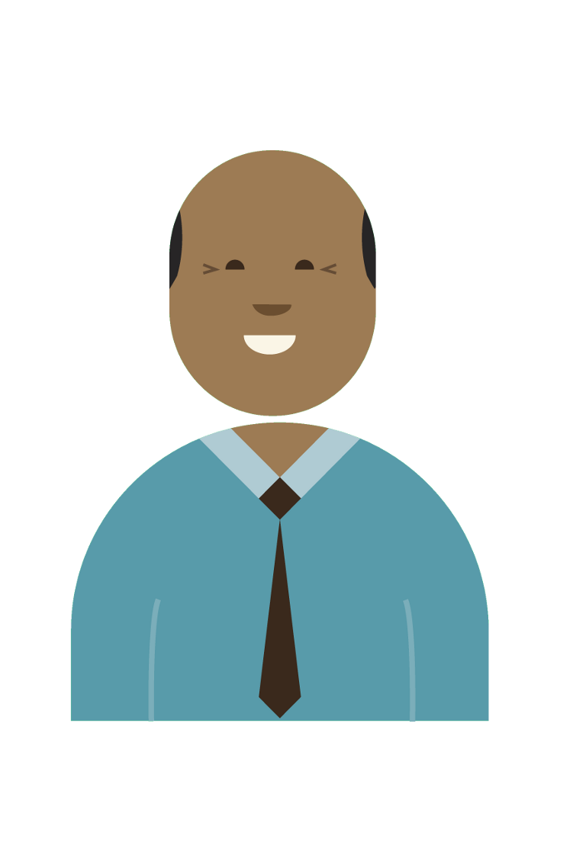
Managing Transitions: Discussion
As an audiologist, how can this tool support your work with families and children and youth as they move through these transitions?
Notes:
5 minutes conversation

Slide 40
Resources: Other Clinical Tools & Articles about Transition
Tools: www.idainstitute.com
My World Pediatric Tool
Telecare for Teens and Tweens
My Turn to Talk for Parents
Articles:
Teens as health-care consumers: Planned transition and empowerment; Emily Pajevic and Kris English; Audiology Today Nov/Dec 2014.
Autonomy, competence, and relatedness in the classroom: Applying self-determination theory to educational practice. Christopher Niemiec and Richard M. Ryan, University of Rochester, New York, USA; Sage Publications, 2009
Planning Successful Transitions from School to Adult Roles for Youth With Disabilities. Gillian A. King, Patricia J. Baldwin, Melissa Currie, and Jan Evans, Thames Valley Children’s Centre, London, Ontario, Canada. Lawrence Erlbaum Associates, Inc. 2005

Slide 41
Resources: Other Clinical Tools & Articles about Transition
Articles continued:
Self-Determination and Student Transition Planning Knowledge and Skills: Predicting Involvement Michael L. Wehmeyer, Susan B. Palmer, Jane H. Soukup, Nancy W. Garner, and Margaret Lawrence Beach Center on Disability University of Kansas; Lawrence Erlbaum Associates, Inc. 2007.
Transitions in the Lives of Children and Young People: Resilience Factors; Scottish Executive Education Department; 2002
Rite of Passage; Hans Henrik Philipsen; Audiology Today, Mar/Apr 2015.
Wellness Skills and Development Chart; Cheryl DeConde Johnson
Kindergarten Transition Workbook: A resource for parents and professionals of deaf and hard of hearing children. BC Family Hearing Resource Centre, 2012.
Parenting a child with chronic illness as they transition into adulthood: A systematic review and thematic synthesis of parents' experiences. Heath, Gemma; Farre, Albert; Shaw, Karen. Patient Education and Counseling, 2016.
Leaving School — What are the options for your deaf child? NDCS, 2016.
Supporting deaf young people through transition: Successful transitions to adulthood for deaf young people in England. NDCS, National Sensory Impairment Partnership, and Department for Education, 2016.

