Slide 1
Changing Landscape: What Members Need to Know to Protect their Services in a Changing Healthcare/Education Environment
KSHA Conference
September, 2017
Janet Deppe, MS CCC-SLP FNAP
Director, State Advocacy

Slide 2
Disclosure:
Janet Deppe, Director State Advocacy
Financial: I am a paid employee of ASHA
Non-Financial: I am an ASHA member, I support ASHA’s Public Policy Agenda which includes the advocacy initiatives that the association supports; I am the ex-officio of ASHA’s School Finance Committee which advocates for increased financial support and other non-financial initiatives for school-based members.

Slide 3
Agenda
1. ASHA’s Public Policy Agenda
2. Federal Overview a. Health Care reform and Policy Issues b. Education Reform and Policy Issues
3. State Issues related to reform
4. State Liaison Model
5. State Hot Topics
6. Hearing Health Care Issues a. HAD scope expansion b. tinnitus management course c. OTC d. LEAD-K

Slide 4

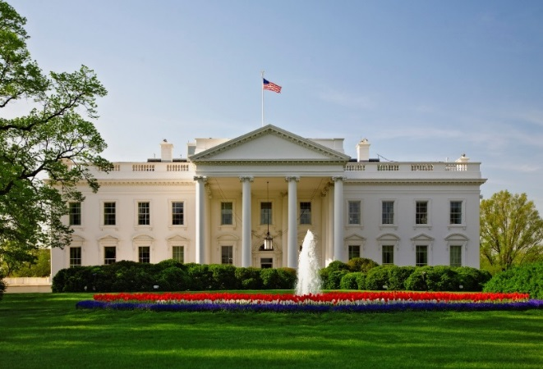
Blueprint for Action: 2017 Public Policy Agenda
The 2017 PPA represents the priority federal, federal-state and state issues that ASHA will use its resources to achieve.

Slide 5
ASHA Public Policy Agenda
Presents ASHA’s plan for legislative and regulatory advocacy and action for 2017 to the BOD for approval.
Developed annually by the GRPPB and guides the advocacy efforts taken on by the Association and its members.
Developed by the 2016 Government Relations and Public Policy Board (GRPPB)
Includes the most pressing policy issues facing our members at the federal and state levels.

Slide 6
Development of 2017 PPA
 | HEALTH CARE | EDUCATION | PROFESSIONAL
FEDERAL | Medicare Reimbursement |  | Social Security Benefit Offsets
FEDERAL-STATE | Medicaid Reimbursement ACA Private Health Plans Hearing Health care Telepractice | Legislation & Regulations Funding & Practice | Loan Forgiveness Demonstrated Value Scope of Practice
STATE |  |  | Licensure Aud/SLP Assistants State Consultants

Slide 7

www.asha.org/uploadedFiles/2017-Public-Policy-Agenda.pdf

Slide 8
The new administration and ASHA PPA
Will our advocacy issues change?
ASHA is a respected organization in Congress and Federal Agencies – we will work aggressively to remain at the table as key policy initiatives are being developed

Slide 9
Key Principles to Remember
There are many unknowns with the new Administration about the future implications of existing laws, regulations, and policies—as well as ones that may be introduced—that could impact ASHA members and those we serve.
ASHA staff will work with the incoming Administration, Congress and our state association partners as we have in the past, and will determine what changes we may need to make in our advocacy strategies as we pursue our 2017 Public Policy Agenda What remains the same, is ASHA's steadfast commitment to ensuring access and opportunity for all ASHA constituents, as well as all of our clients, patients, and students.
Our commitment to diversity and inclusion is unwavering; we will remain vigilant in serving the underserved, advancing cultural competence for our members, advocating for all of our members, and for access to services
for all who need them.

Slide 10
A Civics Refresher
Legislation:
Nothing happened over night
Many bills are introduced:
12,000 + in Congress – 329 passed (3%)
1500 – 2000 in states – 88 passed (approx. 45%)
Laws need to pass in both House and Senate
In Congress:
Senate- 52 Republicans and 48 Democrats
House- 241 republicans and 194 Democrats
In Senate- need 50 votes for nominations and budget reconciliation and 60 votes for all other legislation

Slide 11
Civics refresher continued
Regulatory:
Once a bill is signed into law, regulations are needed to implement the law
Comment period allows for public comment
Executive Orders:
Issued by the President and directed toward agencies and officers of the federal government
Have the full force of law
Executive orders can influence how a law is enforced
Executive orders cannot make law; but rather clarify or act further on a law
Congress can overturn an EO; but President can overturn by veto
2/3 majority in Congress can overturn Presidential
veto

Slide 12
Alternative Facts?
Come from both sides
H.R. 610
State legislation related to licensure
When in doubt – check with the State and Federal GRPP Teams
Not all posts on FB are accurate
Facebook and other social media sights are great sources of information but……
Notes:
HR 610: A bill to distribute federal funds for elementary and secondary education in the form of vouchers to eligible students. It only has 2 co-sponsors and according to a legislative overview site has less than 1% chance of passing ( a statement bill)
Bills to eliminate state licensure: overwhelming support from many sectors- withdrawn

Slide 13
When to Act – When to React – What is ASHA Doing?!?!?!
ASHA’s GRPP Teams are monitoring both federal and state activities and are in contact with state association leaders and Congressional staff
Not all bills need a take action
  Take Action Fatigue
Measured and target take action is the best approach
Opposition needs to be done in a way that does not lock ASHA out of current and potential negotiations.

Slide 14
Advancing ASHA Issues in the Trump Administration
Need for Data
Both healthcare and education policy development will depend significantly on the availability of hard data and verifiable information;
Policy development in both a Republican led Executive and Legislative will be driven by data analytics;
Policy makers will be heavily influenced by an evidence-based approach to problem solving
Increased Need for State Advocacy
States and localities will have more control of both health care and education policy
Provide members with more resources and tools to advocate on health and education issues
Showcase how members have successfully advocated for appropriate health and education policy.

Slide 15
Health Care Reform and Policy Issues

Slide 16
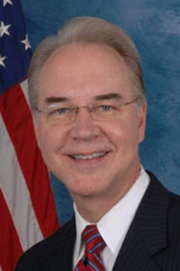
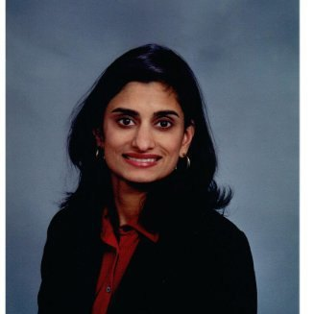
Key Health Care Players
Rep. Dr. Tom Price (R-GA), HHS Secretary
Dr. Seema Varma, CMS Administrator
Notes:
Dr. Tom Price is Chair of the House Budget Committee. As a staunch conservative, he supported eliminating the ACA, and cutting funding for Medicare, Medicaid, CHIP Reauthorization, and Planned Parenthood. He has introduced legislation to turn Medicaid into a block grant program and to cut $910 billion out of the program over 10 years (1/3 of its budget). He supports turning Medicare from an entitlements to a premium support (voucher) program. He supports demonstration projects, but is critical of CMMI, and supports balance billing of Medicare beneficiaries.
Dr. Seema Varma is a Medicaid consultant, CEO of SVC, where she has advised Governors and state Medicaid agencies on Medicaid, insurance and health policy. She is close to VP Pence and helped design the Healthy Indiana Plan, the nation’s first consumer-directed Medicaid program, and worked with Republican governors for Medicaid waivers, work and pay contribution requirements for Medicaid beneficiaries.

Slide 17
State & local government entities
Health Care
Reform –
Trump
Administration’s
Overarching
Ideology
Private sector, not-for-profit, non-profit, and business organizations
Academic & think tank institutions relying on hard data & verified information
Notes:
Market-driven solutions with significant involvement from:
State & local government entities
Private sector, not-for-profit, non-profit, and business organizations
Academic & think tank institutions relying on hard data & verified information

Slide 18
Health Care policy positions adopted by the ASHA BOD
in February 2017
1. Oppose block-granting proposals that would limit federal matching funds to set amounts without regard for changes in enrollment, medical needs, economic downturn, or other variable criteria.
2. Protect school-based Medicaid reimbursement for medically necessary services that are also educationally relevant.
3. Protect the federal Medicaid Early Periodic, Screening, Diagnosis and Treatment (EPSDT) Mandates.
4. Enact consumer protections for access to affordable, quality care, including ensuring access to habilitation services, before repealing the Affordable Care Act (ACA).
Notes:
1. Rationale: Block granting proposals are estimated to potentially reduce federal and state expenditures on health care through the Medicaid program by up to $450 billion over 10 years. Block granting and per capita caps based upon federal poverty census data within states as commonly proposed would dramatically affect members and consumers in states where Medicaid has expanded and where optional populations are covered. Block grants and caps disincentivize enrollment and comprehensive coverage while promoting more restrictive coverage and eligibility criteria. This is a result of capped funding and proposed elimination of federal dollars to support additional enrollment or eligibility.
2. Rationale: School-based reimbursement from Medicaid for medically necessary services that are also educationally relevant would be threatened because the state Medicaid agency would have limited funds and be dis-incentivized to provide coverage for school-based services. School districts would continue to have to comply with IDEA law and ensure a free and appropriate public education. However, without the support of the Medicaid funding, the amount of services available for eligible children would significantly decrease, threatening students’ access to essential services. Employment of members would be negatively affected because of potentially reduced student eligibility for services resulting from increasingly restrictive standards driven by reduced funding.
3. Rationale: Under the proposed block grants, concerns have been raised regarding the federal government’s need to eliminate or relax federal mandates for Medicaid coverage and allow the states increased flexibility to make their own coverage determinations. The EPSDT mandate could be threatened with elimination or weakening of federal standards. There has been some deterioration of the mandate because of varying interpretations of EPSDT by managed care organizations contracted to operate Medicaid in several states.
4. Rationale: Repeal of the ACA prior to an agreement on a replacement strategy that continues to ensure access to quality health care is a threat to the country’s entire health system. Congressional partisanship threatens action on a compromise plan and Congress should not repeal the ACA until a compromise on replacement legislation is agreed upon.
Recent discussions to trim the essential health benefits places habilitation at particular risk moving forward as it was not a commonly covered service under private health plans prior to the ACA passage.
Habilitation provides critical access to medically necessary services for children with developmental delays, congenital disorders, impairments, and conditions that require the skilled services of audiologists and SLPs among a host of other professionals. Habilitation services help maximize an individual’s (commonly a child’s) ability to function as independently as possible, greatly enhancing educational performance, employment independence, and quality of life outcomes. Access to habilitation services must be preserved.
ASHA also recommends re-authorization of the Children’s Health Insurance Program (CHIP) to ensure that children intended to transition to ACA plans do not lose coverage if the ACA is repealed without specific provisions in place to ensure continued access to care for those children.
5. Rationale: While commonly discussed as a means to increase competition and reduce costs, the reality of interstate health plans has proven the opposite with larger entities crowding out smaller plans and reducing overall consumer choice. In addition, current proposals to allow interstate health plans would propose a threat to consumer protection and access to services including audiology and speech-language pathology for a variety of reasons.
First, interstate sale of private health plans would reduce the ability of state insurance commissioners from fully engaging in their consumer protection oversight role and not allow them the ability to fully enforce the laws within their state to ensure appropriate access to care by qualified, licensed, health care professionals.
Second, interstate plan sales would allow establishment of health plans in states with low coverage criteria and consumer protections and provide those plans for sales in states with more comprehensive requirements. This would essentially undermine the hard-fought state mandates we and other health professionals have achieved for autism coverage, habilitation, hearing health, telepractice recognition and co-payment parity.
It is in ASHA’s interest to continue to build our relationships with the National Association of Insurance Commissioners (NAIC), individual state commissioners and join them in opposition to interstate health plan sales. The NAIC has laid out plans for improving competition among health plans to improve consumer access and choice founded on the concept of interstate compacts. Such a proposal dovetails nicely with ASHA’s recent efforts toward developing interstate compacts for licensure of audiologists and speech-language pathologists.
6. Rationale: Recent discussions of privatizing Medicare, providing vouchers for consumer choice, and establishing tax credits for seniors to purchase health care of their choice ignore the reality that many senior citizens face. Too many seniors live in or near poverty or on limited fixed incomes and do not have the resources to buy health insurance on the open market because of pre-existing conditions. The actuarial impact of their age on health risks and premium costs, particularly without Affordable Care Act (ACA) protections, would make coverage unaffordable.
Even more concerning is the concept of providing seniors and individuals with disabilities with tax credits in order to purchase private health care. An overwhelming number of retired Americans and individuals with chronic conditions and disability determinations do not earn enough income to pay any amount of federal taxes. The concept of tax credits as a viable option for the majority of seniors and individuals with disabilities is reckless and undermines the foundational nature of Medicare as an entitlement funded by each individual through payroll taxes over the course of their employment careers.
7. Rationale: Similar to concerns about Medicare premium support proposals, Medicaid initiatives like those implemented in Indiana and elsewhere, to increase co-payments and co-insurance for Medicaid beneficiaries, fail to recognize the limited financial capacity of many individuals and families enrolled in the Medicaid program. While health savings accounts and high-deductible plans have a significant role to play in increasing consumer attention and focus on health care costs, quality and effectiveness, applying them to individuals who cannot afford the co-payments results in delaying and avoiding health care services that often help manage and prevent progression to more serious and costly conditions.

Slide 19
Health Care policy positions adopted by the ASHA BOD in February 2017
5. Oppose Sale of Interstate Health Plans that threaten consumer protections and ASHA supported state mandates for coverage of services provided by audiologists and speech-language pathologists.
6. Oppose Medicare Vouchers, Tax Credits and Premium Support to protect the affordability of care for older Americans and people with disabilities.
7. Oppose Increased Medicaid Cost Sharing and Implementation of High Deductible Health Plans for Low Income Medicaid Beneficiaries.

Slide 20
Health Care Opportunities
Therapy Caps
  CBO/Dynamic Scoring
  Interest to get this done
Telepractice
  Has been discussed by HHS Secretary designate as a means to provide health care
Medicare coverage of audiology services
EHDI
  Worked out concerns
Regulations related to Hearing Aid Dispensers in the VA
Health Care Challenges
Medicaid
  Block grants, EPSDT, multiple ways to manage the program based on state policies
Essential Health Benefits
Hearing Aid Tax Credit
  Tax policy moving in different direction
Over the Counter Hearing Aids
Audiology Medicare Coverage
Notes:
20 years we have been working on Therapy cap reform legislation

Slide 21
Therapy Caps
This year marks the 20th anniversary of implementation of the therapy caps.
Policy does not align with movement towards payments based on quality and outcomes.
ASHA working with other organizations to develop replacement policy.
Current policies expires at the end of the year – action needs to happen this year.

Slide 22
Therapy Caps
Law sets a financial limitation on the amount of Part B outpatient therapy services. Combined PT/SLP cap and a separate OT cap
Since passage – Congress has either placed a moratorium on the implementation or most recently provided for an exceptions process.
High cost of repeal - $18 billion was the last estimate.

Slide 23
EHDI
EHDI legislation has been introduced in both the House and Senate
Legislation reauthorizes the program
Provides for screening of newborns and young children up to the age of 3 and puts more focus on addressing loss to follow-up and follow-up services.
Imperative that bill gets reauthorized before the appropriations process moves forward.

Slide 24
Essential Health Benefits
Vital in helping clients with speech, language, cognitive, swallowing, and hearing/balance/tinnitus disorders achieve, acquire, maintain, or regain skills to improve functional communication outcomes.
Treatment leads to greater social and emotional connections and an improved quality of life.
Treatment leads to enhanced educational, and employment opportunities that increase the likelihood of independent living and may even halt or slow the progression of a disability
An individual’s overall health status improves when hearing/balance/tinnitus and speech-language needs are met.
Research findings also indicate that long-term healthcare costs of individuals with congenital and genetic disorders and developmental disabilities can be curtailed through intensive and comprehensive habilitation treatment early in life.
Council for Affordable Health Insurance estimates that habilitative service mandates cost <1% of the total premium costs in the states with habilitation mandates.
Notes:
House moved the bill through regular order and approved the bill via voice vote
Senate bill introduced – HELP committee promises to have hearing on the bill get getting pushed back.
Last minute concerns raised by HELP staff as a result of technical assistance provided by HHS.
Leadership has assured stakeholders that the bill will move.
HELP committee members need to understand the importance of this legislation.

Slide 25
OTC Hearing Aids
Consumer demand for lower cost devices
Presidents Council on Science and Technology and National Academy of Sciences both support
FDA is in support
  Believe that there is a market for safe and effective lower cost devices
  Has the authority to do so already
    Barrier is state laws

Slide 26
OTC hearing aids
This legislation has passed – making modest changes was the only option.
  Children
  Data collection
  Mild/Moderate hearing loss
    Argument is that no one is going to seek help for mild anyway therefore gateway needs to be for those with moderate loss

Slide 27
Audiology Medicare
Would allow for diagnostic and rehabilitation services to be reimbursed by Medicare
If OTC bill moves – important for audiology services to be covered.
Nominal cost to the Medicare program
Supported by physician groups

Slide 28
Education Reform and Policy Issues

Slide 29
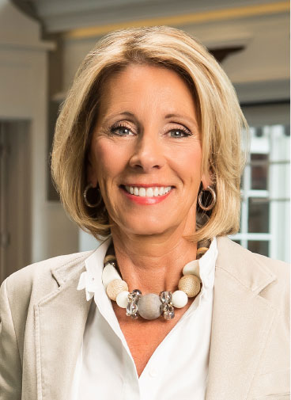
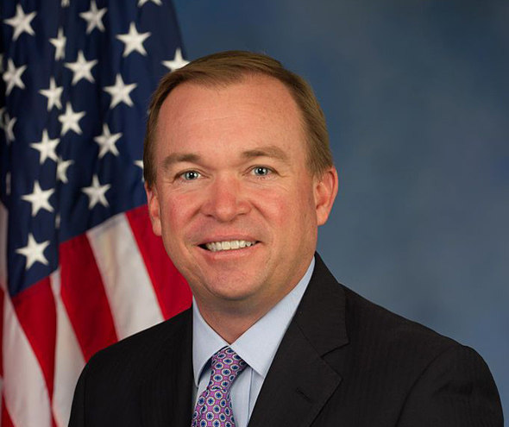
Other Key Nominees
Elizabeth Betsy DeVos, Education Secretary
Rep. Mick Mulvaney (R-SC), OMB Director
Notes:
Betsy DeVos, billionaire businesswoman and philanthropist (Amway), is a strong supporter and advocate for parochial and charter schools. She lobbied for Michigan’s first charter school bill in 1993 and where public money can go for quasi-independent educational institutions. She has supported school choice, vouchers and tax credits for parents sending their children to charter schools.
Rep. Mick Mulvaney (R-SC), a founder of the conservative House Freedom Caucus and Tea party member, is a budget hawk for a balanced budget, less deficit spending and has opposed raising the debt ceiling under the Obama Administration even if the federal government shut down.

Slide 30
Devolution of both policy and resource allocation to state education entities & local school districts
Education Reform –
Trump
Administration’s
Overarching Ideology
Moving away from federal mandates and requirements on the use of federal funds at the state & local levels
Establish more of a partnership between the Federal government and state & local education entities

Slide 31
Trump Administration – Education Policies
School Choice Plan
Vouchers
Money follows the child
States and localities should decide best approach
Privatization of student loans and flexibility in debt forgiveness
Streamline U.S. Department of Education (Civil Rights)
No policies related to IDEA reauthorization
No policies related for ESSA implementation
Notes:
School Choice Plan
Vouchers
Money follows the child
States and localities should decide best approach
Privatization of student loans and flexibility in debt forgiveness
Streamline U.S. Department of Education (Civil Rights)
No policies related for ESSA implementation
No policies related to IDEA reauthorization

Slide 32
ASHA Education Positions
ASHA supports the family’s right to choose the education program for their child’s long as the following principles are met:
  Families are given accurate information about the consequences of their choices; qualifications of providers/teachers; due process protections
  Maintenance of appropriate funding for traditional public schools
  Reporting of student achievement in alignment of public school requirements
  Provision of the full range of general and special education services
  Equal access for families with disabilities (compliance with IDEA, 504, ADA)
  Employ instructional staff who meet state education credentialing requirements
  Ensure that funding follows the child
  Ensure privacy protections under HIPPA and FERPA

Slide 33
ASHA Education Positions
ASHA opposes the abolishment of the US Department of Education (ED) or significantly diminishing the role of ED
  ED ensure that all children receive a high quality education that meets certain standards- without these standards there are hugh disparities between states
  ED monitors state and local education agency compliance with federal education laws and policies including ESSA, IDEA and the Higher Education Act
  ED has an important role in general and special education, English language learners, and at risk students
  ED administers the federal student loan forgiveness program
  ED fosters research and innovation through a competitive grant process

Slide 34
ASHA Education Positions
ASHA opposes the Alice Cogswell and Ann Sullivan Macy Act
  Establishes a precedent of placing the needs of students with visual and hearing disabilities ahead of others identified in IDEA
  Includes mandates and resources developed only for visually and hearing impaired students
  Ignores the requirements of IDEA and the IEP team

Slide 35
Education Opportunities
IDEA Reauthorization
Paperwork
ESSA State Implementation Plans
Protection of related services personnel in modified funding models
Education Challenges
Retaining federal ESSA guidance and regulations
Challenges with managing multiple ways to implement education policies through states and localities
Funding increases for IDEA
Caseload/workload
School Medicaid
Lesser qualified providers

Slide 36
IDEA Blueprint for Reauthorization
Issues addressed:
  IEP Teams
  Paperwork
  Funding Caseload/Workload
  Service Delivery Options
  Implications for students who are deaf or hard of hearing
  IDEA Advisory Commission
  Part C ( Birth to Three)

Slide 37
IDEA Blueprint for Reauthorization
Overarching Principles
  Students with disabilities are first and foremost general education students
  Congress must meet its obligation to fully fund IDEA
  IDEA reauthorization must address the overwhelming paperwork and process burdens on providers which reduce valuable services to students
  Students under part B must be afforded a complete assessment and treatment by all appropriate and qualified providers to ensure that FAPE is provided
  IDEA reauthorization should ensure parity with ESSA

Slide 38
Paperwork
PAPERWORK: Increased expression of member frustration with growth of “paperwork” and other administrative burdens.
Worked with Congress to request GAO study.
Worked with GAO to advance study.
Incorporating recommendations for IDEA re-authorization.

Slide 39
Caseload/workload
Despite growth in the professions, shortages still exist for many school districts.
Addressing caseload by considering entire workload can have positive effects on morale and student outcomes.
ASHA has worked with states & districts to pilot workload but needs more from IDEA.

Slide 40
ESSA State implementation Plans
ASHA developed an ESSA Guide that included 11 general areas of interest and included an analysis and member impact, what members can do, a vignette and resources
ASHA created a advocacy tool sent to state associations to ensure that audiologists and SLPs were included in ESSA state implementation plans

Slide 41
School Based Medicaid Services
School districts can be reimbursed by Medicaid for providing Early Periodic Screening, Diagnosis, and Treatment Benefits (EPSDT
Medicaid reimbursement for some or all of the health-related services provided under IDEA when the services are provided to Medicaid-eligible children
ASHA supports efforts to oppose health reform measures that would reduce or eliminate funding for school based Medicaid services

Slide 42
Others issues of importance to the States
Opportunities
Hearing Aid Dispensers - Use VA regulations and DOL rescinding recognition of apprenticeship program to curtail scope expansion
Telepractice
Expansion of Medicaid Coverage
Interstate Licensure Compact - creation of licensure compact will allow greater flexibility to practice across state lines.
PACE Promotion
Accountability Measures - states will be allowed to develop their own
Challenges
Expansion of scope of practice by other providers – market driven environment offers greater competition for shrinking funds in both health care and education
Tight State Budgets as more responsibility is transferred to the states
Medicaid
Changes in Medicaid funding may impact Medicaid dollars going to the schools
Protect State Mandates that positively impact our members and consumer

Slide 43
Direct State Liaison Model ASHA State Advocacy Team
2200 Research Boulevard
Rockville, Maryland 20850
800-498-2071 (toll free) 301-296-8577 (fax)
www.asha.org/uploadedFiles/Direct-State-Liaison-Model-Map.pdf
Washington
Montana
Maine
North Dakota
Minnesota
Vermont
Oregon
New Hampshire
Idaho
South Dakota
Wisconsin
New
York
Massachusetts
Wyoming
Michigan
Rhode Island
Connecticut
Iowa
Pennsylvania
New Jersey
Nevada
Nebraska
Indiana
Ohio
DC
Delaware
Utah
Illinois
West
Virginia
Maryland
California
Colorado
Virginia
Kansas
Missouri
Kentucky
North
Carolina
Oklahoma
Tennessee
Arizona
New Mexico
Arkansas
South
Carolina
Alabama
Georgia
Mississippi
Texas
Louisiana
Hawaii
Florida
Alaska
Janet Deppe - jdeppe@asha.org, ext. 5668
CENTRAL REGION
IL, IN, IA, KS, MO, MI, MN, NE, ND, OK, SD, TX, WI
Eileen Crowe - ecrowe@asha.org, ext. 5667
WESTERN REGION
AK, AZ, CA, CO, HI, ID, MT, NV, NM, OR, UT, WA, WY, Overseas
Susan Adams - sadams@asha.org, ext. 5665
NORTHEASTERN REGION
CT, DC, DE, MA, MD, ME, OH, NH, NJ, NY, PA, RI, VT
Cheris Frailey – cfrailey@asha.org, ext. 5668
SOUTHERN REGION
AL, AR, FL, GA, KY, LA, MS, NC, SC, TN, VA, WV

Slide 44




ASHA State Outreach Model
 Northeast Region – MA, NH, VT, NY, RI, CT, NJ, PA, DE, MD, OH, ME, DC
Susan Adams sadams@asha.org, 800-4 800-498-2071, ext. 5665
 South Region – VA, WV, KY, NC, TN, SC, GA, FL, AL, MS, LA, AR
Cheris Frailey cfrailey@asha.org, 800-498-2071, ext. 5666
 Central Region – ND, SD, NE, KS, OK, TX, MO, IA, MN, WI, IL, IN, MI
Janet Deppe jdeppe@asha.org, 800-498-2071, ext. 5668
 West Region – HI, AK, CA, OR, WA, NV, ID, UT, AZ, NM, CO, WY, MT, Overseas
Eileen Crowe ecrowe@asha.org, 800-498-2071, ext. 5667
Notes:
Our job is to assist state within our regions with legislative and regulatory issues, association issues including leadership succession and volunteer recruitment and provisions of ASHA resources, trends, and national perspective. We also want to serve as your “go to” person at the National Office so that you as leaders and members won’t have to wait or be referred around the office , but will be able to contact us directly ( direct line is on my business card) and if we can’t answer your questions, we will find the correct person in the office who can.

Slide 45
State Outreach Initiative
Divides the country into 4 regions
Assign state liaison for each region
Responsible to communicate with leadership in states in the region
Provider resources and assistance to leaders and members
Attend state conventions/meets with board and members and delivers presentations
Tracks legislation and regulations in the states and provides talking points and testimony to help members advocate in favor of or opposition to legislation and regulation that impact members and individuals we serve

Slide 46
State Advocacy Hot Topics

Slide 47
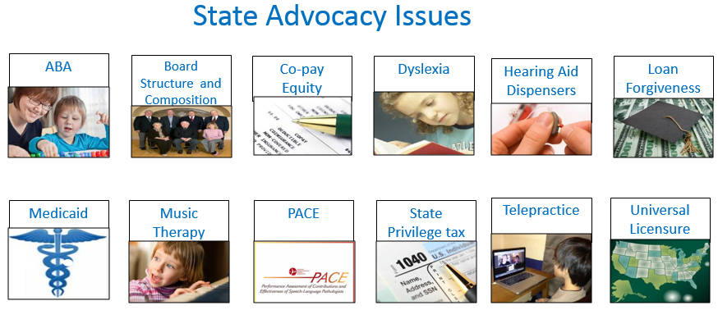
Advocacy - Hot Topics in the States

Slide 48
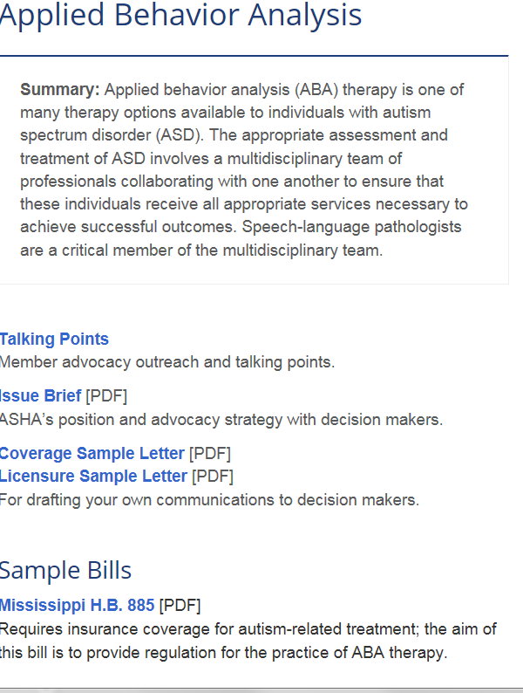

Slide 49
ABA Therapists
Organizations representing ABA therapists are supporting Licensure for ABA therapists and assistants-Currently 24 states license ABA therapists
ASHA has developed a whitepaper which we shared with the US DOE indicating that some students with ASD are being denied FAPE because ABA therapists are acting as gatekeepers in the IEP and IFSP process, restricting access to SLPs and other service providers
Both CMS and US Dept. of ED issued guidance letters to states on the appropriate use of ABA therapy. See the letters referenced here: http://www.asha.org/News/2015/ED-Issues-Guidance-to-Ensure-Access-to-Speech-Language-Pathology-Services-for-Children-with-Autism/
Notes:
ASHA recommends that the U.S. Department of Education provide necessary oversight by examining the practices of state and localities to ensure that:
◻ FAPE is provided to students with ASD and is an individual determination made on a case-by-case basis that ensures the full complement of appropriate providers and services are available.
◻ The ABA therapist may serve as a member of the team, but may not restrict access to services of speech-language pathologists and other specialized instructional support personnel (SISPs), such as occupational therapists.
◻ ABA therapists are not performing tasks and functions outside of their scope of practice and that speech-language pathologists, who are qualified providers, are fully engaged in the assessment and decision-making process for students with ASD as part of the IEP/IFSP team.
◻ No one treatment method is recommended or used for all students with ASD.
◻ Ensure the compliance monitoring process addresses these recommendations.
American Speech-Language-Hearing Association (ASHA)
January 2015
Action: ASHA requests that the U.S. Department of Education (ED) issue a statement that ABA is not the only therapy that schools can offer to children with ASD and that the school systems that rely solely on ABA for ASD are in violation of FAPE. ASHA also requests ED to issue a policy statement that indicates that children with ASD must be provided with the full complement of services to meet their individual needs.
ASHA recommends that the U.S. Department of Education provide necessary oversight by examining the practices of state and localities to ensure that:
◻ FAPE is provided to students with ASD and is an individual determination made on a case-by-case basis that ensures the full complement of appropriate providers and services are available.
◻ The ABA therapist may serve as a member of the team, but may not restrict access to services of speech-language pathologists and other specialized instructional support personnel (SISPs), such as occupational therapists.
◻ ABA therapists are not performing tasks and functions outside of their scope of practice and that speech-language pathologists, who are qualified providers, are fully engaged in the assessment and decision-making process for students with ASD as part of the IEP/IFSP team.
◻ No one treatment method is recommended or used for all students with ASD.
◻ Ensure the compliance monitoring process addresses these recommendations.

Slide 50
Hearing Aid Dispenser Scope of Practice
Hearing Aid Dispenser Scope of Practice
North Carolina expanded the Scope of Practice for HADs
  Changes include allowing:
    hearing aid specialists to interpret certain tests
    refer for cochlear implants, rehab and medical intervention
    determine candidacy for tinnitus management
    provide tinnitus management
    administer cerumen management
    provide community services to individuals with hearing loss
  ASHA is concerned about proposals to expand HAD scope of practice and has opposed bills in other states. HADs have an aggressive campaign to expand their scope arguing that the shortage of audiologists necessitates the expansion. We believe that other bills will surface in state legislatures in the coming years

Slide 51
Federal Loan Forgiveness Programs
Two types of federal programs SLPs and audiologists may qualify for:
  Public Service Loans
  Teacher loan forgiveness

Slide 52
State Loan Forgiveness
Texas passed legislation authorizing loan forgiveness for school based audiologists and speech-language pathologists and PhD students in communication sciences and disorders who commit working in higher education in 2013.
  No funds were appropriated by the legislature
  TSHA committed $300,000 to jump start the loan repayment law and plans to join with other donors to increase the amount of available funds beyond the $300,000 contribution
  The Texas Council of Administrators in Special Education (TCASE) is joining with TSHA in supporting this funding effort.
  Mississippi established a master’s degree loan forgiveness scholarship program for SLPs working in MS schools
    In 2014, funds were appropriated by the MS legislature to support the school loan forgiveness program

Slide 53
Music Therapy Licensure
Music therapy (MT) licensure bills were proposed in IA, IL, MO, CA, CO and FL
ASHA opposed these proposals due to the broad scope of MT practice, including assessment and treatment of communication disorders
Currently five states GA (limited provisions), ND, NV, RI and UT regulate MTs through licensure
WI registers MTs
NY recognizes MT as a sub-specialty under creative arts

Slide 54
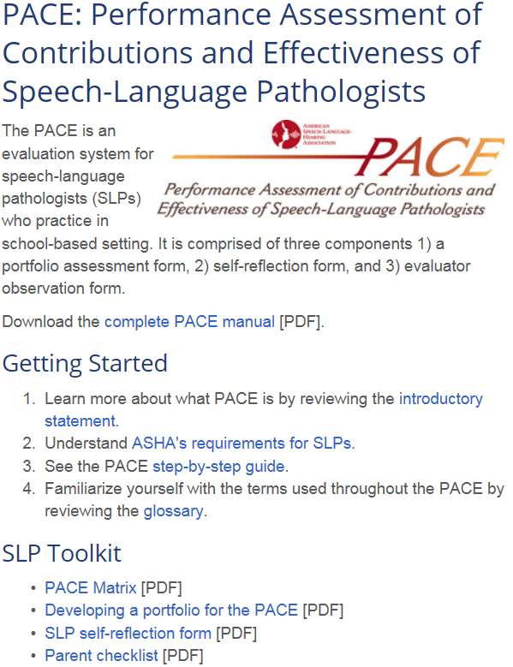
PACE

Slide 55
PACE: Performance Assessment of the Contributions and Effectiveness of SLPs
ASHA’s (PACE) is comprised of a Self‐Reflection Tool, the PACE Observation Form, and the PACE Matrix
Based on ASHA’s Roles and Responsibilities of Speech‐Language Pathologists in Schools policy document and used to evaluate the portfolio and findings on the PACE Observation Form.
In 2015 PACE was revised and streamlined
  PACE is being adapted and piloted in several states and school districts
  The PACE is being modified for SLPs engaged in asessment only
  An MOU was developed with the University of Missouri NEE Center which allows them to expand the use of the NEE teacher evaluation tool which includes the PACE matrix into other states. For more information on the MO model go to: http://nee.missouri.edu/resources.aspx
Oklahoma’s HB 1142, introduced in 2015, instructs the State Board of Education to adopt the PACE for school based SLPs
See ASHA’s Performance Assessment of Contributions and Effectiveness of Speech-Language Pathologists (www.asha.org/Advocacy/state/Performance-Assessment-of-Contributions-and-Effectiveness/).

Slide 56
Telepractice
ASHA has been actively involved in promoting the use and appropriate regulation of telepractice.
  Currently, 19 states regulate telepractice services and six states reimburse speech-language pathology services delivered via telepractice in education settings.

Slide 57
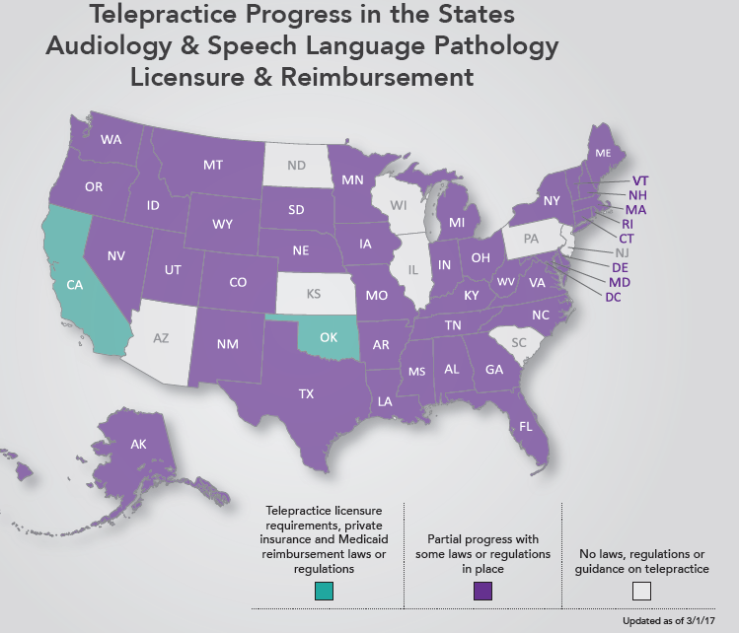
Telepractice Licensure

Slide 58
Hearing Health Care Issues
  Hearing Aid Dispensers Scope Expansion
  Over the Counter Hearing Aids (OTC)
  Tinnitus Management course-sponsored by the International Hearing Society (IHS)
  Veteran’s Administration’s Fit to Serve

Slide 59
LEAD-K Campaign
LEAD-K is a campaign sponsored by National Association for the Deaf to ensure that children who are deaf or hard of hearing have early access to American Sign Language (ASL)
LEAD-K believes that deaf children are not kindergarten ready because they do not have foundational visual language

Slide 60
LEAD-K bills in states
Nine states have introduced lead-K bills this year. Some examples;
  Alabama
  West Virginia
  Michigan

Slide 61
Connect with States
State-By-State Requirements and Contact Information http://www.asha.org/advocacy/state/
State Education Advocacy Leaders (SEALS) http://www.asha.org/advocacy/state/seals/
State Advocates for Reimbursement (STARs) http://www.asha.org/practice/reimbursement/private-plans/reimbursement_network/
State Advocates for Medicare Policy (StAMPs) http://www.asha.org/Practice/reimbursement/medicare/StAMP/

Slide 62
Questions?
Janet Deppe , KS State Liaison
jdeppe@asha.org

