Slide 1
Dementia Therapy Essentials for the SLP Speaker Peggy Watson M.S., CCC-SLP Denver, Colorado www.consultantsindementiatherapy.com www.consultants-in-dementia-therapy.myshopify.com JOIN THE CONVERSATION on facebook.com/consultantsindementiatherapy

Slide 2
Disclosure
Relevant financial relationship This presentation is based on the book titled
Dementia Therapy & Program Development
owned by Consultants in Dementia Therapy (CDT).
Owner receives royalties from sale of said book.
CDT is owned by Peggy Watson M.S., CCC-SLP.

Slide 3
The speech-language pathologist has a primary role in the screening, assessment, and treatment of dementia-associated cognitive-communication disorders, including caregiver training and counseling. (ASHA)

Slide 4
“Dementia”
Alzheimer’s Dementia
Vascular Dementia
Lewy Body Dementia
Frontotemporal Dementia

Slide 5
Alzheimer’s
Brain Tour
alz.org

Slide 6
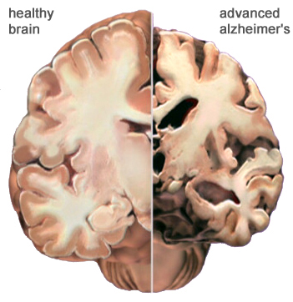

Slide 7
‘Retrogenesis’
LONG TERM MEMORY
Episodic Memory
Semantic Memory
Procedural Memory

Slide 8
STAGING
Staging gives us a look at
spared (preserved) vs. impaired
capabilities -
Staging assists in planning:
When is it inappropriate to write a memory goal?
When communication begins to breakdown
When negative behaviors may emerge
When the person may be entering their own reality

Slide 9
Global Deterioration Scale for Dementia
Dr. Barry Reisberg, et. al.
free resource online!
(Notice the FUNCTIONAL CHANGE from stage to stage)
Stage 1: No Cognitive Decline
Stage 2: Minimal Cognitive Decline
- forgetting where one has placed a
familiar object
- forgetting names one formerly knew well
- personal concern about the symptoms

Slide 10
Stage 3: Mild Cognitive Decline
word and name finding deficit evident on clinical interview
patient may have gotten lost when traveling to unfamiliar location
co-workers may become aware of patient’s relatively poor performance
anxiety about the symptoms

Slide 11
Stage 4: Moderate Cognitive Decline
decreased knowledge of current and recent events
may exhibit some deficit in memory of one’s personal history
concentration deficit elicited on serial subtractions

Slide 12
Stage 5: Moderately Severe Cognitive Decline
patient can no longer survive without some assistance
patient is unable during interview to recall a major relevant aspect of their current lives
frequently disoriented about time (date, day of week, season, etc)

Slide 13
Stage 6: Severe Cognitive Decline
may occasionally forget the name of the spouse upon whom they are entirely dependent
diurnal rhythm frequently disturbed
(diurnal=active during the daytime)
frequently continue to be able to distinguish familiar from unfamiliar persons in environment

Slide 14
Stage 7: Profound Cognitive Decline
verbal abilities lost
incontinent, requires assistance toileting and feeding
loses basic psychomotor skills
(ex: ability to walk)
the brain appears to no longer tell the body what to do

Slide 15
Suggested Evaluation/Staging Tools
FLCI: Functional Linguistic Communication Inventory
ABCD: Arizona Battery for Communication Disorders of Dementia
FROMAJE: Function, Reason, Orientation, Memory, Arithmetic, Judgment & Emotional Status
FAST: Functional Assessment Staging Test
GDS: Global Deterioration Scale

Slide 16
Establishing Medical Necessity
Identify functional change
Functional change:
impacts a person’s ability to
function in their environment

Slide 17
ST examples of functional change
-Increasingly confused, disoriented
-Change in memory
-Impaired safety and judgment
-Change in swallowing safety
-Non-purposeful chewing at mealtime
-Change in orientation
-Increased confusion
-New or increased wandering
without purpose
Functional change should be documented

Slide 18
Developing Goals
Always relate goals to functional outcomes
All goals should be:
a) functional for the patient’s
capabilities according to stage
and living environment
b) Skilled, Measurable, Reasonable
and Necessary
3 parts: 1. What you’re going to do
2. Make it measureable
3. Why this is necessary

Slide 19
Communication Goal
LTG: Pt will utilize a communication system compatible with spared skills for functional expression of basic & medical needs by mastery of the objectives/STGs.
[what can ‘functional expression’ be? Could be speech, pointing to picture/symbol/word/phrase, gesture...]
STG: Pt. will increase appropriate communication exchanges 8 of 10 opportunities in a session to develop expression of basic needs.
Daily Note:
AAC (augmentative alternative communication)
(ex: memory book) was used to cue episodic memory to increase the patients communication to 5 of 10 targeted opportunities within a session.

Slide 20
AAC Strategies and Tools for Persons With Dementia
Michelle Bourgeois, PhD, CCC-SLP; Melanie Fried-Oken, PhD, CCC-SLP; Charity Rowland, PhD
The ASHA Leader, March 2010, Vol. 15, 8-11. doi:10.1044/leader.FTR1.15032010.8
AAC, in the form of external aids that incorporate stimuli highly relevant to a person’s daily life, may include memory wallets, notebooks, calendars, signs, color codes, timers, communication boards, labels, and other tangible visible symbols that provide cues for interaction. Persons with dementia use AAC successfully, and SLPs may want to demonstrate to patients and caregivers the effectiveness of these tools.
To ensure reimbursement, goals and progress notes should reflect how speech-language treatment helps the patient to be more functional. For example, using AAC strategies may help the patient increase functional communication or participation in daily living activities, or decrease agitation.
Janet Brown MA, CCC-SLP, director of health care services in speech-language pathology
See entire article: http://leader.pubs.asha.org/article.aspx?articleid=2291890

Slide 21
MORE SLP STGs:
Patient will demonstrate recall of functional information 70% of opportunities using visual aids/AAC with mod assist to increase independence in living environment.
[Decrease demands on working memory by providing compensatory strategies]
Patient will demonstrate auditory comprehension of simple yes/no questions with 70% accuracy in order to communicate functional thoughts, needs, wants and/or feelings.
Patient will increase functional problem solving with 70% acc and mod cues in order to increase safety and reduce fall risk during daily living tasks.

Slide 22
Interventions
Sensory
Reminiscence
Spaced Retrieval
Montessori
Validation

Slide 23
Sensory
(Burns, Byrne, Ballard, Holmes, 2002)
Sensory interventions involve the
patient’s sense of touch, taste,
hearing, smell or sight, or some
combination of these.

Slide 24
Sight (Visual Stimulation) – Vision is our most important sense, the one through which we gain most of our information
Hearing (Auditory Stimulation) – Our ears probably provides us with our second most vibrant source of sensory stimulation
Smell (Olfactory Stimulation) – Some of our strongest memories, our most potent associations, are triggered by odor
Taste (Gustatory Stimulation) – In many ways taste is the most pleasurable of our senses, depending on how much emphasis one puts on food and eating
Touch (Tactile Stimulation) – Anything touched and anything that touches us can be stimulating. Every solid object has texture, temperature, shape
Sensory Stimulation for Alzheimer’s
By JOHN SCHMID ON February 17, 2009

Slide 25
Alive Inside Dramatic Effects of Music! www.musicandmemory.org
Dr. Oliver Sacks
www.youtube.com/watch?v=QG7X-cy9iqA

Slide 26
Reminiscence Therapy
(Chiang, Chu, Chang, et al., 2010)
Refers to a collection of
memories from the past

Slide 27
Using Long Term Memory Think Back .... 1. Do you like music? 2. What were you doing at 21? 3. What was your first car? 4. What did you do for a living? 5. Who was your favorite comedian?

Slide 28
Spaced Retrieval
Cameron Camp, PhD et al.
Gradually increases the interval
between correct recall of target
items

Slide 29
Spaced Retrieval:
Possible treatment targets include the use of compensatory strategies for swallowing, safe transfer techniques, the names of caregivers, and the use of memory aids (e.g. schedules and calendars). Achievement of these goals can promote independence and reduce anxiety, as well as improve interactions between the client and clinician or caregiver.
It’s important to choose memory targets that are personal, functional, and perhaps most importantly, won’t change.
http://tactustherapy.com/spaced-retrieval-training-memory/

Slide 30
Montessori for Dementia
Montessori Based Programming for Dementia®
Developed by Cameron Camp, PhD
Guided by the principles of Dr. Maria Montessori who claimed that children who were engaged and interested in what they were doing did not exhibit problematic behaviors such as pushing, screaming or
acting out in inappropriate ways.
Connecting past interests and
skills with the present spared
skills and needs of the patient.

Slide 31
Video of a woman using a duster

Slide 32
Examples of
Montessori Treatment Activities
1. Sorting buttons
2. Rolling balls of yarn
3. Sorting sugars
4. Sorting nuts and bolts
5. Sorting fabrics
6. Flower arrangements
7. Sorting socks
8. Clipping coupons

Slide 35
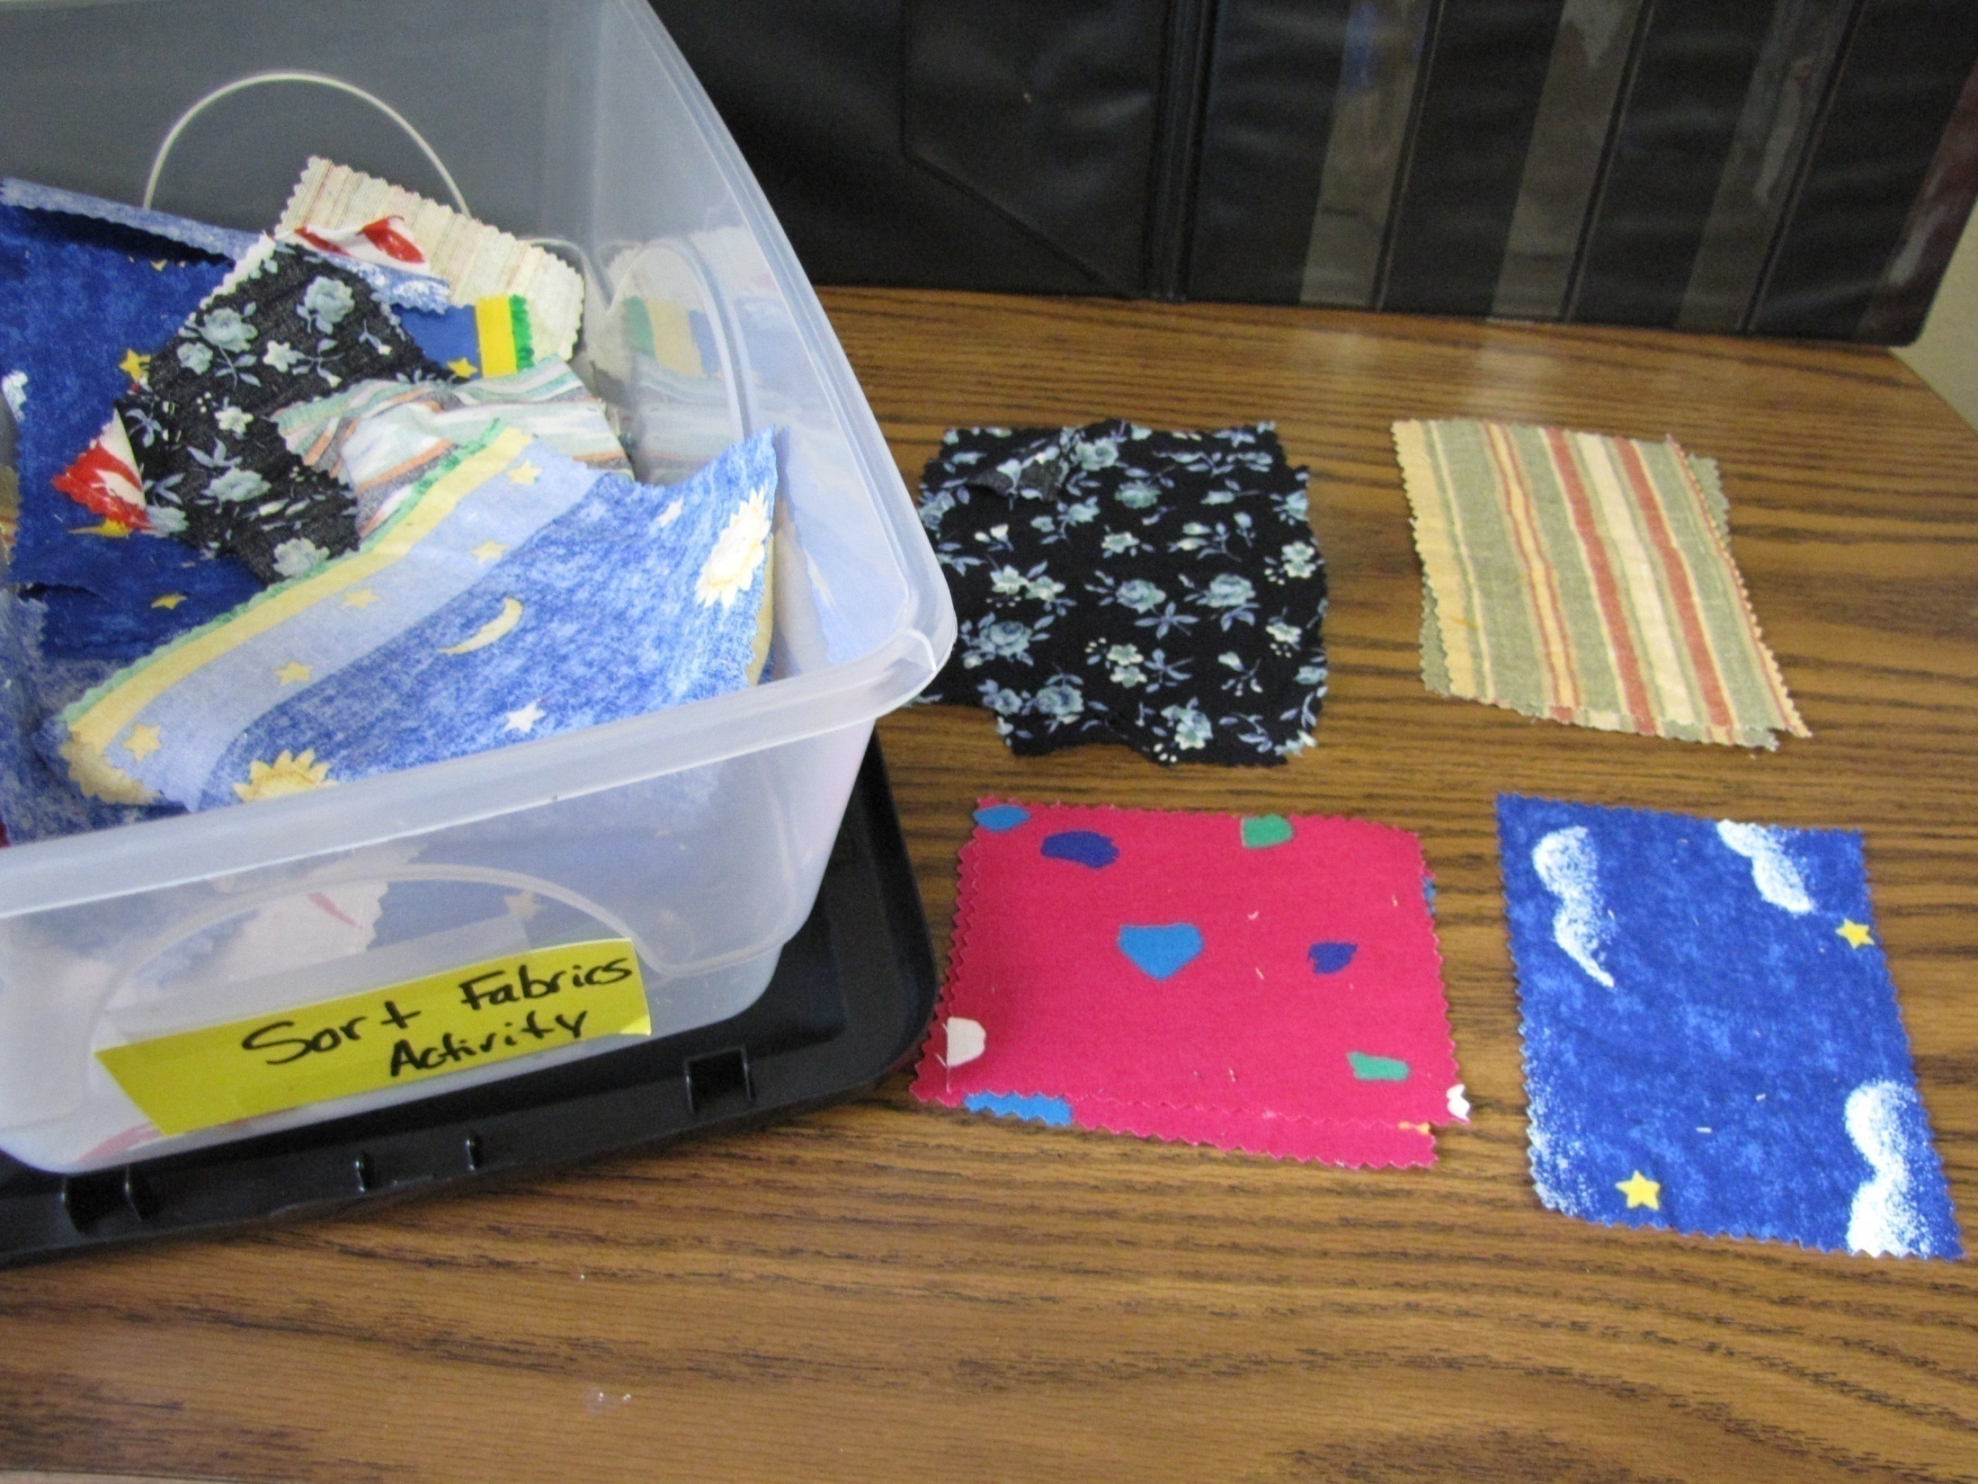

Slide 36
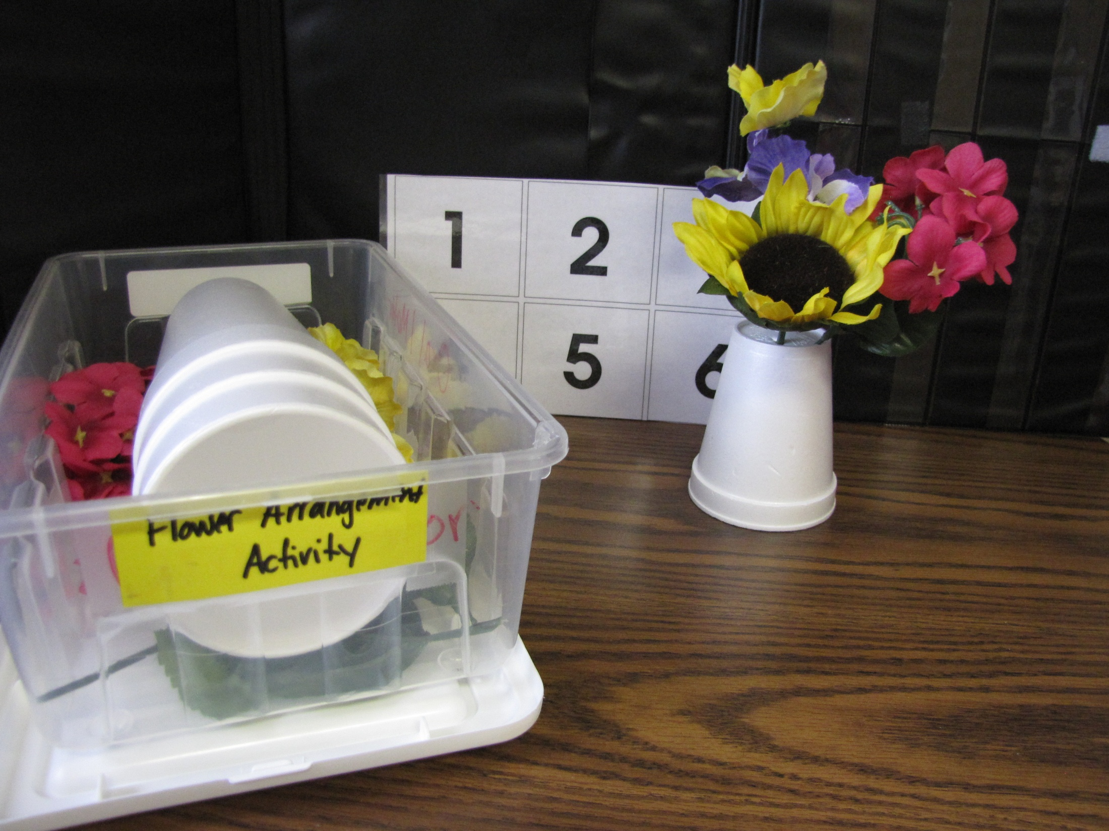

Slide 37
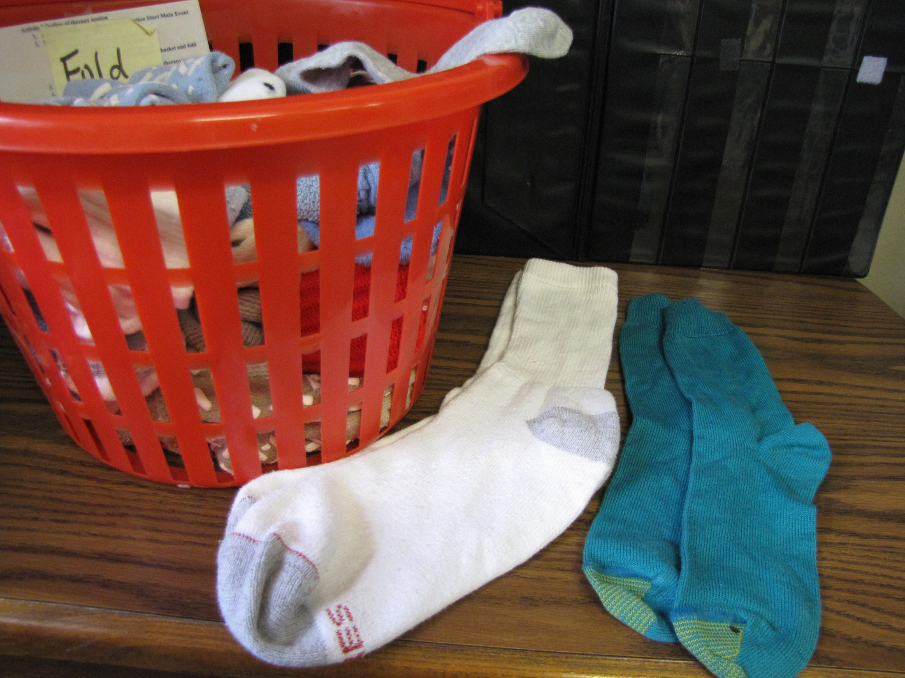

Slide 39
Validation Naomi Feil
Communicating with a person with dementia by validating and respecting their feelings.
It is their reality you will be validating, not yours!

Slide 41
Thank You!
Peggy Watson M.S., CCC-SLP
Consultants In Dementia Therapy
www.consultantsindementiatherapy.com
JOIN THE CONVERSATION ON FACEBOOK
www.facebook.com/consultantsindementiatherapy

