Slide 1
Post-Extubation Dysphagia (PED)
Angela Parcaro-Tucker, MA, CCC-SLP, LSVT®

Slide 2
Disclosure
I have no proprietary interest in any products or methods mentioned; neither I nor members of my family have any equity interest in any of the products or methods covered; and I have not and do not receive payments - either formal or any kind - for any product or method discussed.I have no proprietary interest in any products or methods mentioned; neither I nor members of my family have any equity interest in any of the products or methods covered; and I have not and do not receive payments - either formal or any kind - for any product or method discussed.

Slide 3
A Brief Review
Definition of Post-extubation Dysphagia (PED): the difficulty or inability to effectively and safely transfer food and liquid from the mouth to the stomach after extubation.
The research is varied, due to differences in study design and populations covered.
Overall, it appears that PED is common. However, studies indicate a wide range of incidence, reflecting that 10-84% of those who are intubated experience some form of PED.

Slide 4
Why the large range?
Differences in populations selected
Duration of intubation being as little as 24 hours for some studies
Timing of testing for some studies (some tested immediately after extubation, and some did not test swallow for at least 48 or 72 hours post-extubation)

Slide 5
A Closer Look at Factors that Make Range of Incidence so Broad
Populations studied
Trauma ICUs
Whole hospitals
Cancer Centers
Cardiac ICUs
Stroke/Neuro populations
Heart failure
Surgical ICUs
The range of RISK FACTORS among these populations varies greatly.

Slide 6
Risk Factors Identified in Studies
Pre-existing Factors (Factors existing prior to intubation/extubation)
Neurological Conditions or Pre-existing Stroke
Congestive Heart Failure (CHF)
Forced supine position
Head and Neck Cancer (HNC)
Recent Transesophageal Echocardiogram (TEE)
Presence of Tracheostomy/large bore NG tube
Aged 55+ (a 37% increased risk compared to younger people)

Slide 7
Factors Occurring During/Concurrent with Intubation
Peri-operative stroke
Peri-operative sepsis

Slide 8
Risk Factors Identified in Studies (Cont’d)
Factors Directly Related to Intubation (Mechanical Causes)
Duration of Intubation – some studies indicate EACH day of intubation increased PED by 14%, other studies gave general incidence of 34-56% of patients intubated greater than 48 hours display dysphagia.
Endotracheal tube size
Laryngeal injury
Failed extubations/repeated intubations
Disuse atrophy (lingual function/strength as well as laryngeal and pharyngeal strength)
Other Factors
Medications/narcotics
Cognitive impairment of critical illness

Slide 9
What is considered “Prolonged Intubation?”
Some studies declared 24 hours a prolonged intubation
Most considered 48 hours or longer to be a prolonged intubation
There were a few studies that studied those who were intubated 72 hours or longer

Slide 10
Timing of Swallowing Evaluation
Range of PED swallow assessments on studies were anywhere from immediately after extubation to 72 hours post-extubation, which makes it problematic to compare studies for incidence.
45% of patients of any age aspirate in the first 24 hours post-extubation
At 48 hours post-extubation, 36% of young people aspirate and 52% of those 65+ aspirate. But remember those other risk factors discussed earlier!
Much of said aspiration in the early hours after extubation is SILENT.

Slide 11
Methods of Evaluation by Speech Pathology
60% of evaluations were at bedside alone, without instrumental diagnostic
Gold Standard Instrumental Diagnostics – one study indicated the average time elapsed between extubation and instrumental diagnostic was 3.17 days, with a range of 0 days to 18 days:
VFSS (or MBSS)
FEES
Other methods covered in studies:
pH-Manometry – most often utilized with esophageal dysphagia
Scintigraphy
Requires 3 hours “not eating” prior to exam
Utilizes rapid sequence images rather than continuous video
Only thin liquid and a “jellied liquid” are tested
A wait time of 30 minutes takes place and the exam is repeated
There is a potential for quantifying volume aspirated

Slide 12
What about Nursing Screenings?
KU Medical Center developed a screening tool called KUPIDS. It is evidence-based, and there are three sections.
Part I is a history, with pre-existing factors outlined
Part II are observations of patient at bedside
Part III is PO administration.
Central Baptist Hospital developed a screening tool, as well, with three sections
Part I includes weighted scale for factors observed at bedside prior to providing PO. These factors are chosen based on the evidence that exists for higher risk individuals.
Part II is the sum of the weighted factors from Part I plus observations of secretion management.
Part III is the PO portion. Small sip, then 1 tsp applesauce, then 2-3 consecutive sips of water. If any portion of this results in s/s aspiration, the pt is to be NPO and SLP consulted.

Slide 13
What Now?
We need more research!
For now, we will work with the research we have.

Slide 14
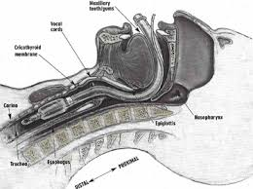
A Bit of Anatomy Image credit: JEMS.com

Slide 15
You’ve received orders for PED eval…
Thorough chart review: PMH, timing/type of intubation, length of intubation, current medical status, time of extubation
Determining timing of PED evaluation based on what is learned in chart review.
Facilities may have their own protocols that have to be followed.
Use clinical judgment based on the risk factors.
Managing expectations requires constant education! Engage nurses and doctors to help with managing expectations.

Slide 16
You’ve received orders for PED eval (Cont’d)
Talk to the Nurse!
Is the patient awake/alert?
Following commands?
Managing secretions?
How’s the voice?
Discuss timing of evaluation and meds that are scheduled

Slide 17
Evaluating for PED (cont’d)
Thorough Oral-Mechanism exam
Labial structure and function
Lingual structure and function (be sure to fully assess retraction!)
Palatal structure and function
Presence of sores/lesions/blood
Secretion management
Vocal quality and strength

Slide 18
Evaluating for PED (cont’d)
You may determine after the oral-mechanism exam that the patient is not yet a candidate for oral trials.
If the patient is a candidate for oral trials, proceed.
Instrumental diagnostic if indicated.

Slide 19
Most Prominent Physical Features of PED
Lingual weakness, particularly at base of tongue and with retraction
Pharyngeal weakness, particularly superior and anterior laryngeal excursion

Slide 20
PED Impact on Swallow Function
Delayed response to bolus entering pharynx. This can be due to sensory impairment, motor impairment from disuse atrophy, or a combination of the two.
Decreased base of tongue retraction results in residue at valleculae.
Decreased hyolaryngeal excursion from disuse atrophy results in decreased airway protection/epiglottic valving as well as residue at valleculae.
Decreased pharyngeal constriction from disuse atrophy can result in posterior pharyngeal wall residue.
Decreased vocal fold approximation or laryngeal trauma decreases airway protection.

Slide 21
Let’s see some of this in action!
MBS normal https://www.youtube.com/watch?v=PwVreNrTKBw
MBS aspiration https://www.youtube.com/watch?v=1sFNMk87558
FEES normal https://www.youtube.com/watch?v=RATbA4m_-TE
FEES aspiration https://www.youtube.com/watch?v=hTfXLkmtYgM

Slide 22
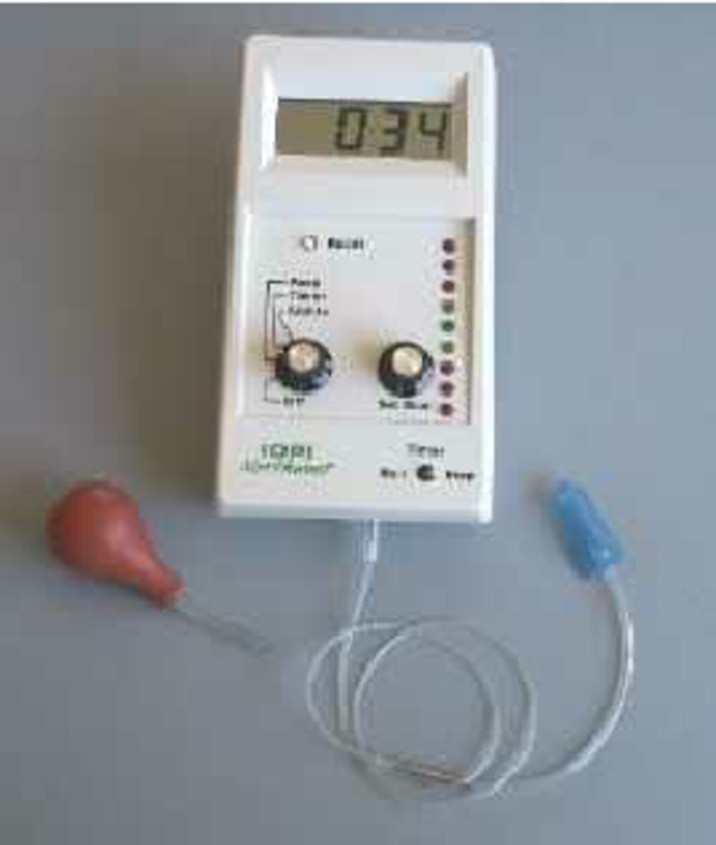
Additional measures – may or may not be available in the facility
Strength of the tongue:
IOPI: The Iowa Oral Performance Instrument

Slide 23
Additional measures, continued
Pharyngeal and UES manometry
Conducted by gastroenterologist and radiologist
Often coincides with fluoroscopy
Confounding factors can include gender and age; bolus viscosity is a factor

Slide 24
Treatment
Sensory Deficit or Delayed Swallow
Thermal/Tactile/Gustatory Stimulation
Lemon-glycerin swabs
Cold/iced laryngeal mirror
DPNS (if certified)

Slide 25
Treatment for Motor Deficits
Poor Base of Tongue Retraction
Effortful Swallow
Higher level cognition: Have patient push tongue “back and down” and swallow hard
Open mouth swallow
Drag tongue tip posteriorly along palate; try to reach soft palate

Slide 26
Treatment for Motor Deficits
Poor superior pharyngeal constriction
Masako
Poor Laryngeal Elevation/Poor UES opening
Mendelsohn
Falsetto/High Pitch sustained “eeee”
Shaker
Chin Tuck Against Resistance
Jaw Opening Against Resistance

Slide 27
Treatment for Motor Deficits
Poor Vocal Fold Closure
Careful with those who have had lower motor neuron or edema/traumatic intubations causing their poor vocal fold closure
Gentle: Breath hold and release
More aggressive – and also for improved laryngeal closure:
Supraglottic swallow
Super Supraglottic swallow

Slide 28
Other Tools and Modifications
FEES as diagnostic + biofeedback
Postural changes
Chin tuck
Behavioral changes
Bolus hold and swallow
Refrain from using straws
Small bolus
Diet texture changes

Slide 29
Things to Take Away from all of this Research
We have an idea of which populations are at greatest risk of developing PED.
We have a great idea of which aspects of the swallow are most impacted by prolonged intubation.
We already know how to treat the swallow deficits caused by prolonged intubation – no stress trying to reinvent the wheel.
It would be nice to have research that directs us as to WHEN is the best time for SLP evaluation of the swallow post-extubation.

Slide 30
My Favorite Thing to Remember in a World of Evolving Practices

Slide 31
References
Ajemian, M., et. al. (2001). Routine Fiberoptic Endoscopic Evaluation of Swallowing Prolonged Intubation. Archives of Surgery. 136:434-37.
Barker, J., et al. (2009). Incidence and Impact of Dysphagia in Patients Receiving Prolonged Endotracheal Intubation After Cardiac Surgery. Canadian Journal of Surgery. 52(2):119-25.
Barquist, E., et al. (2001). Postextubation Fiberoptic Endoscopic Evaluation of Swallowing after Prolonged Endotracheal Intubation: A Randomized, Prospective Trial. Critical Care Medicine. 29(9).
Bishop, M.J., Hibbard, A.J., & Fink, B.R. (1985). Laryngeal injury in a dog model of prolonged endotrachael intubation. Anesthesiology,51, 73-77.
Burgess, III G.E., Cooper Jr., J.R., Marino, R.J., Peuler, M.J., & Warriner, III, R.A. (1979). Laryngeal competence after tracheal extubation. Anesthesiology 51:1,73-77.
Colice, G.L., Stukel, T.A. & Dain, B. (1989). Laryngeal complications of prolonged intubation. Chest, 96, 877-884.
Colonel, P, Houze, H., Vert, H., Mateo, J., Megarbane, B., et al. (1998). Swallowing disorders as a predictor of unsuccessful extubation: a clinical evaluation. Amer J Crit Care, 17:6, 505-510.
Davis, F.G. & Cullen, D.J. (1974). Post-extubation aspiration following prolonged intubation. American Society of Anesthesiologists Annual Meeting, American Society of Anesthesiologists, Washington, DC, 181-182. (Unable to obtain this study.)
de Larminat, V., et al. (1995). Alteration in Swallowing Reflex after Extubation in Intensive Care Unit Patients. Critical Care Medicine. 23(3):486-90.

Slide 32
References
El Solh, A., Okada, M., Bhat, A., & Pietrantoni, C. (2003). Swallowing disorders post orotracheal intubation in the elderly. Intensive Care Med, 29, 1451-1455.
Ferraris, V.A., Ferraris, S.P., Moritz, D.M., & Welch, S. (2001). Oropharyngeal dysfunction after cardiac operations. Ann Thorac Surgery, 71:6, 1792-1795.
Goldsmith, T. (2000) Evaluation and treatment of swallowing disorders following endotracheal intubation and tracheostomy. Int Anesthesiol Clin., 38, 219-42.
Hewitt, A., et al (2008). Standardized Instrument for Lingual Pressure Measurement. Dysphagia 23:16–25.
Hogue, Jr C.W., Lappas, G.D., Creswell, L.L. et al. (1995). Swallowing dysfunction after cardiac operations. Associated adverse outcomes and risk factors including intraoperative transesophageal echocardiography. J Thorac Cardiovasc Surg, 110:2, 517-522.
Keeling, W.B., Lewis, V., Blazick, E., Maxey, T.S., Garrett, J.R., & Sommers, K.E. (2007). Routine evaluation for aspiration after thoracotomy for pulmonary resection. Ann Thorac Surg, 83:1, 193-196.
Langmore, S., et al. (2015). Efficacy of exercises to rehabilitate dysphagia: A critique of the literature. International Journal of Speech-Language Pathology; Early Online: 1–8.
Leder, S.B., Cohn, S.M. & Moller, B.A. (1998). Fiberoptic endoscopic documentation of the high incidence of aspiration following extubation in critically ill trauma patients. Dysphagia, 13, 208-212.

Slide 33
References
Macht, M., et al. (2011). Postextubation Dysphagia is Persistent and Associated with Poor Outcomes in Survivors of Critcal Illness. Critical Care Medicine. 15(5).
Macht, M., et al. (2012). Diagnosis and treatment of post-extubation dysphagia: Results from a National Survey. J Crit Care. Dec; 27(6): 578–586.
Padovani, A.R. Moraes, D.P., de Medeiros, G.C., et al. (2008). Orotracheal intubation and dysphagia: comparison of patients with and without brain damage. einstein, 6:3, 343-349. (Unable to obtain this study.)
Rassameehiran, S., et al (2015). Postextubation Dysphagia. Baylor University Medical Center Proceedings. 28(1) 18-20.
Rousou, J.A., Tighe, D.A., Garb, J.L. et al. (2000). Risk of dysphagia after transesophageal echocardiography during cardiac operations. Ann Thorac Surg, 69:2, 486-489.
Skoretz, S.A., Flowers, H.L., & Martino, R. (2010). The incidence of dysphagia following endotracheal intubation. Chest, 137:3.
Stanley, G.D., Bastianpillai, B.A., Mulcahy, K., & Langton, J.A. (1995). Postoperative laryngeal competence. The laryngeal mask airway and tracheal tube compared. Anaesthesia, 50:11, 985-986.
Tolep, K., Getch, C.L. & Criner, G.J. (1996). Swallowing dysfunction in patients receiving prolonged mechanical ventilation. . Chest, 109, 167-172.

Slide 34
THANK YOU!!!
Angela Parcaro-Tucker, MA, CCC-SLP, LSVT
Rehabilitation Coordinator and Speech-Language Pathologist
Via Christi Hospitals
Wichita KS
Angela.parcaro-tucker@ascension.org

